Slide 1

To duplicate click on the object and then control D
Or you may move the object with your mouse.
1^{ST & 2nd} Grade Word Math Problem 1
LESSON 1
At the zoo there are 14 Monkeys in the cage. 8 of the monkeys are adults and the rest are baby monkeys draw below in the boxes below a circle for each monkey. How many monkeys are babies? ______
Total Babies? ____
ADULTS
BABY MONKEYS

Slide 2
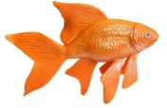
LESSON 2
There are 13 fish in the fish tank. Lisa has 3 fish and the rest of the fish are Bobbies Please draw fish in the boxes below to answer this question. How many fish are Bobby’s fish___?
To duplicate click on the object and then control D
Or you may move the object with your mouse.
Total FISH? ____
LISA
BOBBY

Slide 3
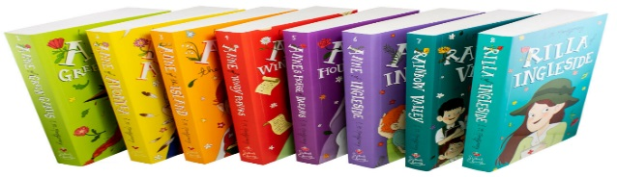
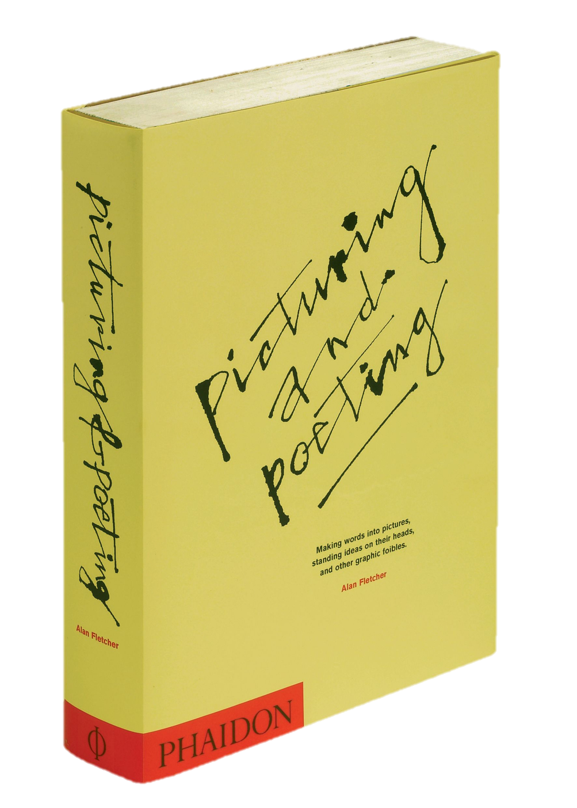
To duplicate click on the object and then control D
Or you may move the object with your mouse.
LESSON 3
Penny read 8 of the 19 books that were on the shelf. Her brother Danny read the rest of the books on the shelf. How many books did Danny read? Please draw below books in Danny’s box to answer this question. How many Books did Danny read ______?
Total BOOKS? ____
PENNY
DANNY
Penny read 8 of the 19 books that were on the shelf. Her brother Danny read the rest of the books on the shelf. How many books did Danny read? Please draw below books in Danny’s box to answer this question. How many Books did Danny read ______?

