Slide 1
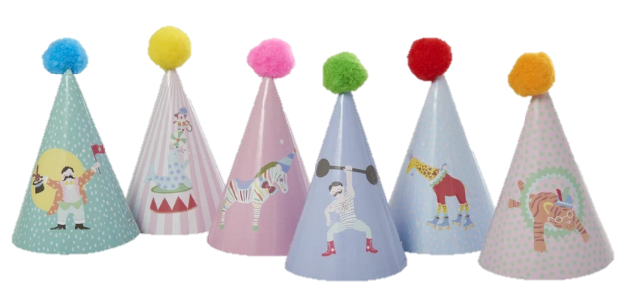
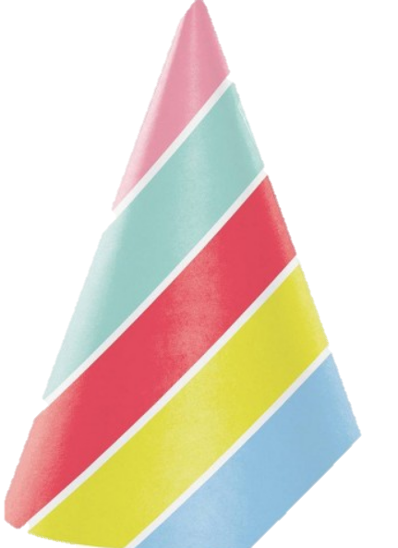
To duplicate click on the object and then control D
Or you may move the object with your mouse.
1^{ST & 2nd} Grade Word Math Problems 2
LESSON 1
Carol is having a party she had 6 party hats and then she found 5 more. How many hats does she now have___?
Total Babies? ____
Party Hats
BABY MONKEYS

Slide 2
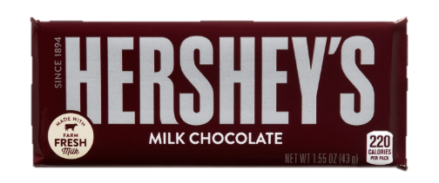
LESSON 2
Jim has 8 candy bars and Kathy has 4 Candy Bars. How many candy bars do they both have all together___?
To duplicate click on the object and then control D
Or you may move the object with your mouse.
____ Total
Jim’s Candy Bars
Kathy’s Candy Bars

Slide 3
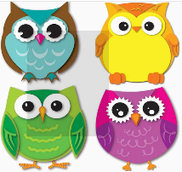
To duplicate click on the object and then control D
Or you may move the object with your mouse.
LESSON 3
On the tree in the back-yard Patty saw 10 Owls on the left side of the tree. A few minutes later 4 more owls came to the right side. How many owls where there all together ____?
Total BOOKS? ____
Owls left side of tree
Owls right side of tree
Penny read 8 of the 19 books that were on the shelf. Her brother Danny read the rest of the books on the shelf. How many books did Danny read? Please draw below books in Danny’s box to answer this question. How many Books did Danny read ______?

