Slide 1
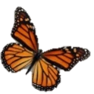
To duplicate click on the object and then control D
Or you may move the object with your mouse.
1ST & 2nd Grade Word Math Problem 3
LESSON 1
Linda was looking at her flowers. She counted 10 butterfly's and then 4 butterfly's flew away. Cross off the ones that flew away. How many butterflies are there still on her flowers? ___?
Left ? ____
On the flowers
Flew a away

Slide 2

LESSON 2
Carl was looking at the pond in his back yard. He counted 9 Frogs. He thew some food into the pond and 5 frogs jumped into the pond. How many Frogs are there in the pond now ___?
To duplicate click on the object and then control D
Or you may move the object with your mouse.
Total Frogs? ____
Frogs in the pond
Frogs that jumped in

Slide 3
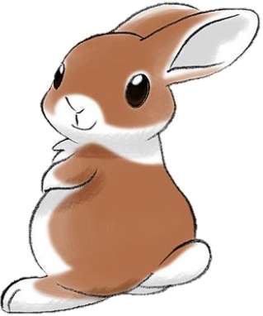

To duplicate click on the object and then control D
Or you may move the object with your mouse.
LESSON 3
Mrs Smith in the morning looked under the deck in the back yard and saw 6 bunnies. She looked back again later that day and saw 5 more brown bunnies. How many bunnies are now under the deck______?
Total BOOKS? ____
PENNY
DANNY
Penny read 8 of the 19 books that were on the shelf. Her brother Danny read the rest of the books on the shelf. How many books did Danny read? Please draw below books in Danny’s box to answer this question. How many Books did Danny read ______?

