Slide 1
Score
Team 1
Team 2
1
2
3
4
5
6
7
8
9
10

Slide 2
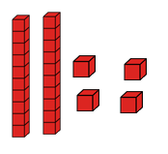
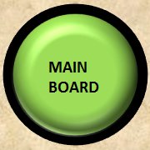
Question - 1
What is the number?
20
22
24
25
24

Slide 3
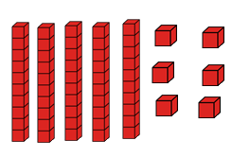
Question - 2
What is the number?
44
46
56
50
56

Slide 4
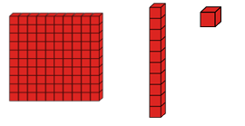
Question - 3
What is the number?
11
100
111
110
111

Slide 5
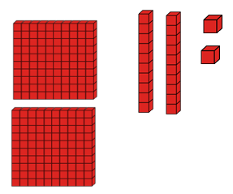
Question - 4
What is the number?
200
220
222
240
222

Slide 6
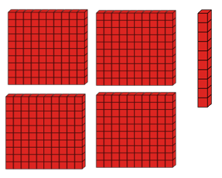
Question - 5
What is the number?
410
400
41
421
410

Slide 7
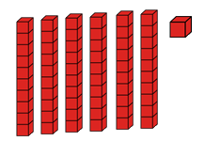
Question - 6
What is the number?
51
41
61
60
61

Slide 8
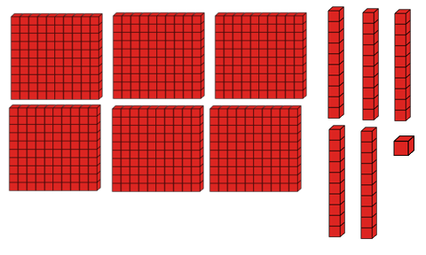
Question - 7
What is the number?
640
641
661
651
661

Slide 9
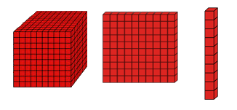
Question - 8
What is the number?
1000
1,100
1,110
1,111
1,110

Slide 10
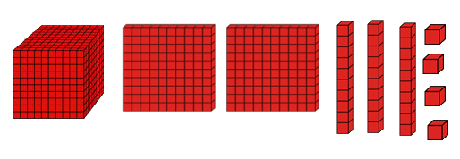
Question - 9
What is the number?
1,221
1,234
1,224
1,244
1,234

Slide 11
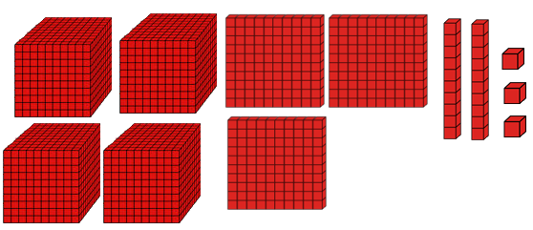
Question - 10
What is the number?
7,323
4,223
4,323
4,423
4,323

