Slide 1
Score
Team 1
Team 2
1
2
3
4
5
6
7
8
9
10

Slide 2

Question - 1
Attracts bees to help pollinate and reproduce.
Seeds
Leaves
Roots
Flowers
Flowers

Slide 3
Question - 2
Keeps the plant in the soil
Stem
Flowers
Roots
Seeds
Roots

Slide 4
Question - 3
Come from mature plants and starts the plant life cycle again.
Seeds
Stem
Leaves
Apples
Seeds

Slide 5
Question - 4
Carries water and nutrients to and from all the other parts of the plant.
Flowers
Leaves
Stem
Root
Stem

Slide 6
Question - 5
Plants need _______ to survive.
Water, Oxygen
Dirt, Water and Air
Water, Air and Sunlight
Water only
Dirt water & air

Slide 7
Question - 6
An animal that east only plants.
Lettuce
Herbivore
Omnivore
Carnivore
Herbivore

Slide 8
Question - 7
A ______ is a natural disaster where there is a lack of precipitation for long periods of time.
Drought
Tornado
Landslide
Flood
Drought

Slide 9
Question - 8
A ______ is a natural disaster where great flowing or overflowing of water onto land that is not normally covered by water.
Tornado
Earthquake
Landslide
Flood
Flood

Slide 10
Question - 9
A ________ is a natural disaster where there is a sudden and violent shaking of the ground.
Drought
Earthquake
Landslide
Flood
earthquake

Slide 11
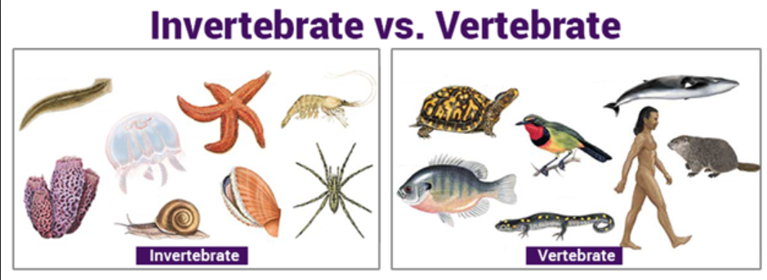
Question - 10
Animals with backbones are
vertebrates
invertebrates
Vertebrates

