Slide 1
Score
Team 1
Team 2
1
2
3
4
5
6
7
8
9
10

Slide 2
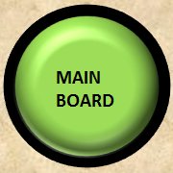
Question - 1
13 + 7 =
20

Slide 3
Question - 2
15 + 5
20

Slide 4
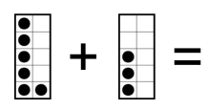
Question - 3
9

Slide 5
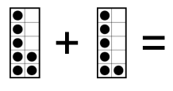
Question - 4
13

Slide 6

Question - 5
Antonyms
A. Down

Slide 7
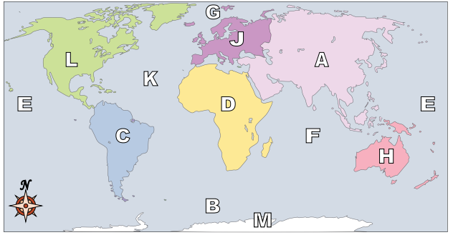
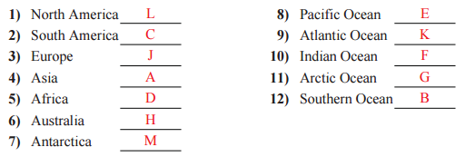

Slide 8

Question - 7
I would like a __________ of pie.
piece peace
Piece

Slide 9
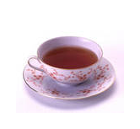
Question - 8
I would like a cup of _______.
Tee tea
tea

Slide 10

Question - 9
I will __________ a story.
write right
write

Slide 11
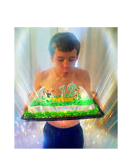
Question - 10
The boy ________out his candles.
blue blew
blew

