Slide 1


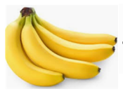
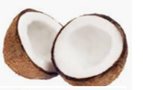


+
+
= 30
= 18
+
+
-
= 2
+
= ____
+

Slide 2





+
+
= 12
+
= 18
+
+
= 10
=____
+
+

