Slide 1


Significant Figures Practice
Directions:
Click & Drag the circle to place it over the correct number of significant figures of the number shown or for the calculations, the answer.
Notes:
Click and drag the blue circle to show the correct addition answer.

Slide 2
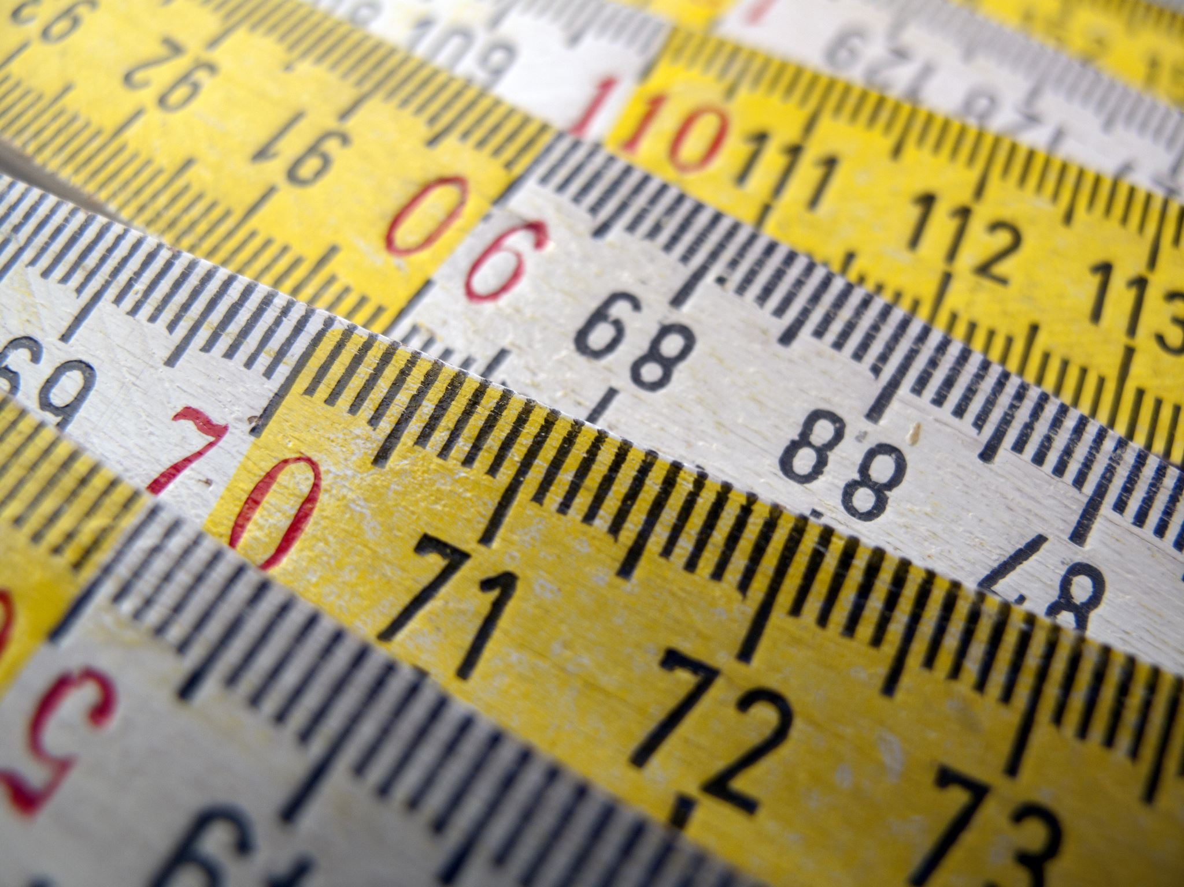
0.003m
1 2 3 4 5 6 7 8 9 10
Notes:
Click and drag the blue circle to show the correct addition answer.

Slide 3
0.004200 cm
1 2 3 4 5 6 7 8 9 10
Notes:
Click and drag the blue circle to show the correct addition answer.

Slide 4
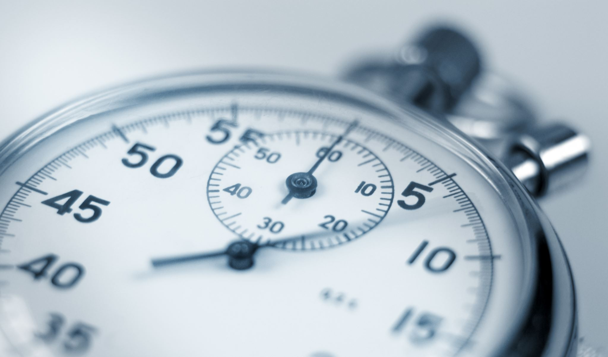
1.003 s
1 2 3 4 5 6 7 8 9 10
Notes:
Click and drag the blue circle to show the correct addition answer.

Slide 5
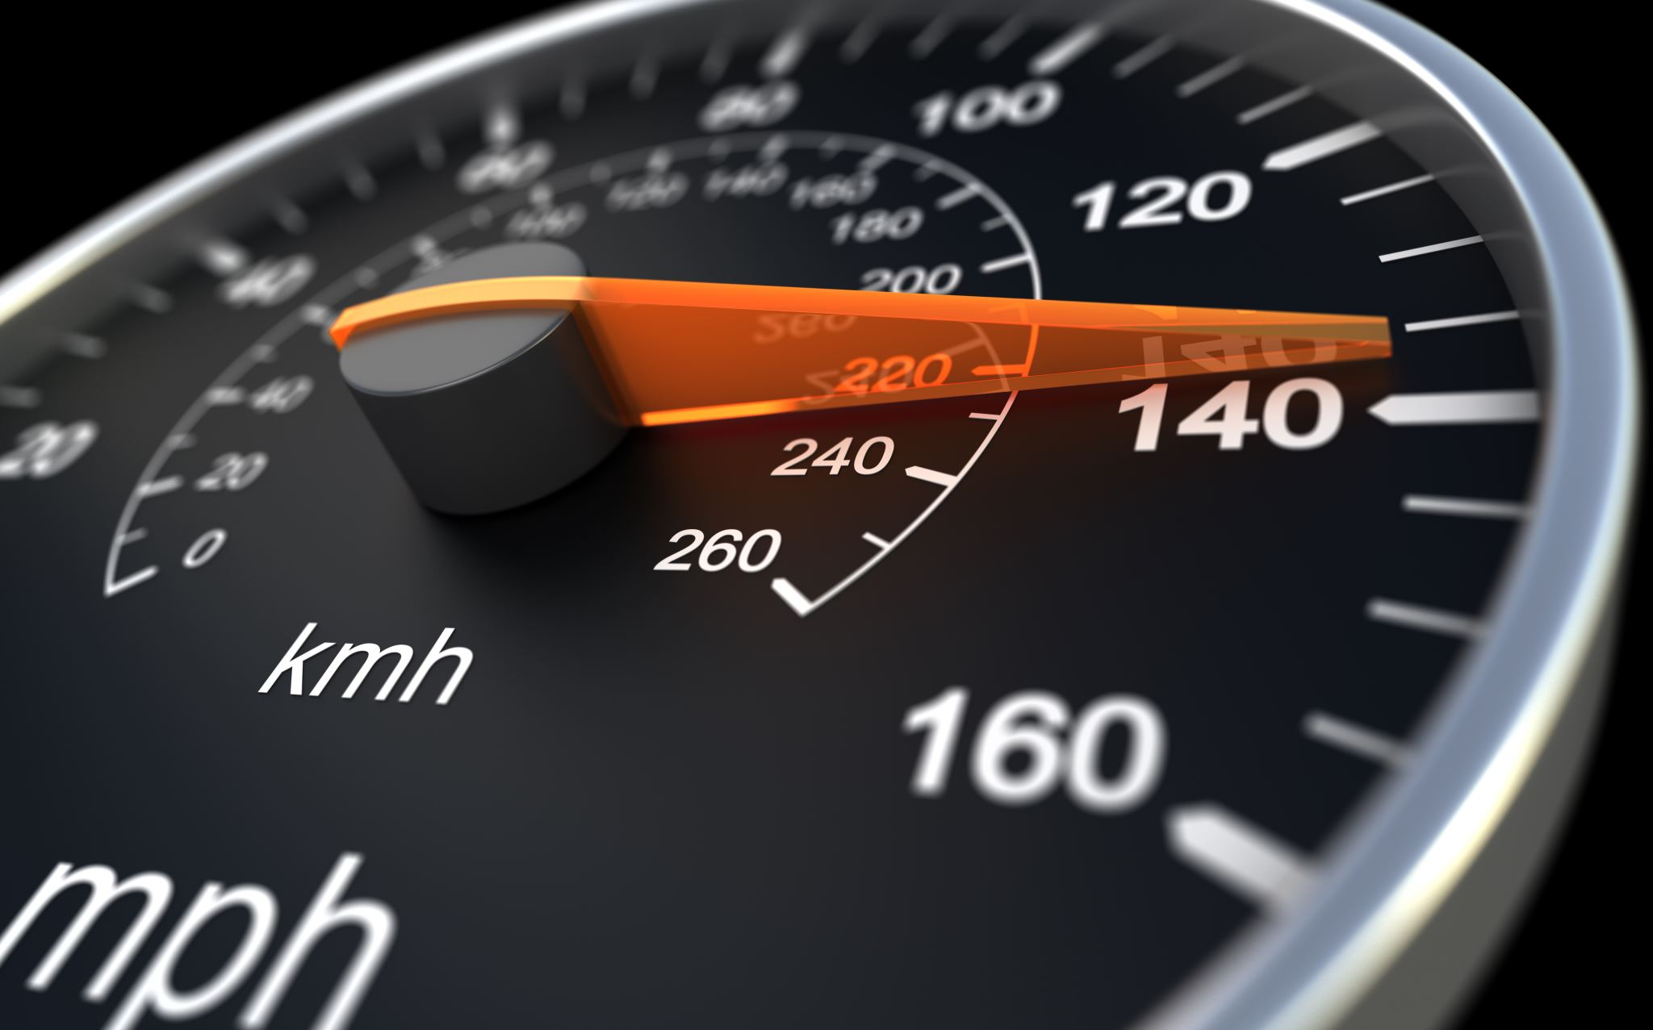
200 km/hr
1 2 3 4 5 6 7 8 9 10
Notes:
Click and drag the blue circle to show the correct addition answer.

Slide 6
145.00 km
1 2 3 4 5 6 7 8 9 10
Notes:
Click and drag the blue circle to show the correct addition answer.

Slide 7
5.4cm + 2.3cm + 4.56cm =
1 2 3 4 5 6 7 8 9 10
Notes:
Click and drag the blue circle to show the correct addition answer.

Slide 8
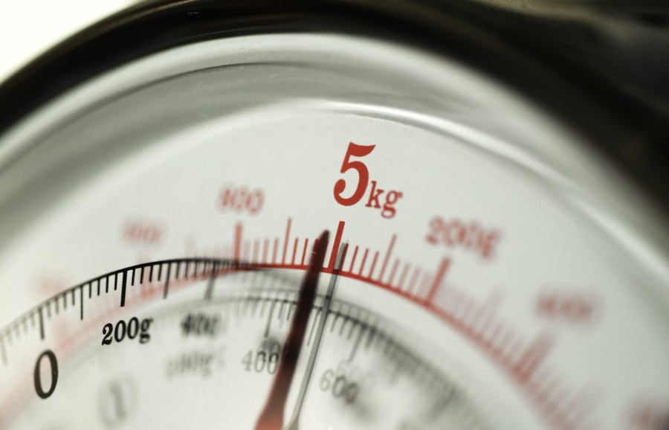
2.5g X 2g =
1 2 3 4 5 6 7 8 9 10
Notes:
Click and drag the blue circle to show the correct addition answer.

Slide 9
1.500kg-3.45kg =
1 2 3 4 5 6 7 8 9 10
Notes:
Click and drag the blue circle to show the correct addition answer.

Slide 10
5.6mph-3mph =
1 2 3 4 5 6 7 8 9 10
Notes:
Click and drag the blue circle to show the correct addition answer.

Slide 11

4.53m x 10 people =
1 2 3 4 5 6 7 8 9 10
Notes:
Click and drag the blue circle to show the correct addition answer.

Slide 12

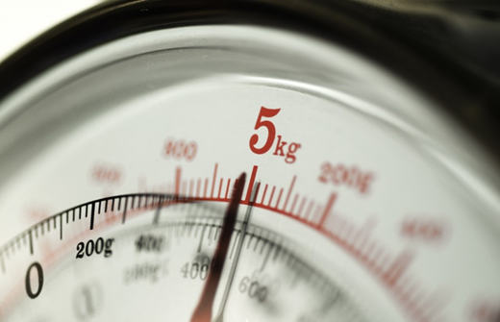
Well Done!
Don’t forget to turn it in at the end!
Notes:
Click and drag the blue circle to show the correct addition answer.

