Slide 1
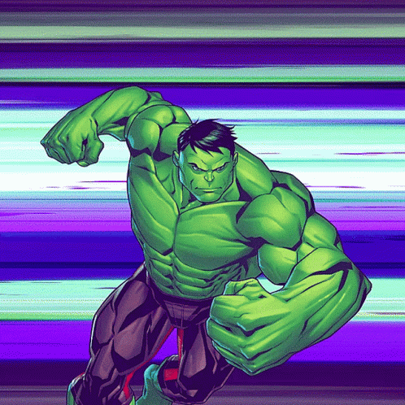





WHOLE NOTE INTO 4 PIECES!
What note value is each piece now?
Drag the circle onto your answer!

Slide 2
HALF NOTE INTO 2 PIECES!
What note value is each piece now?
Drag the circle onto your answer!

Slide 3
QUARTER NOTE INTO 2 PIECES!
What note value is each piece now?
Drag the circle onto your answer!

Slide 4
WHOLE NOTE INTO 2 PIECES!
What note value is each piece now?
Drag the circle onto your answer!

Slide 5
HALF NOTE INTO 4 PIECES!
What note value is each piece now?
Drag the circle onto your answer!

Slide 6
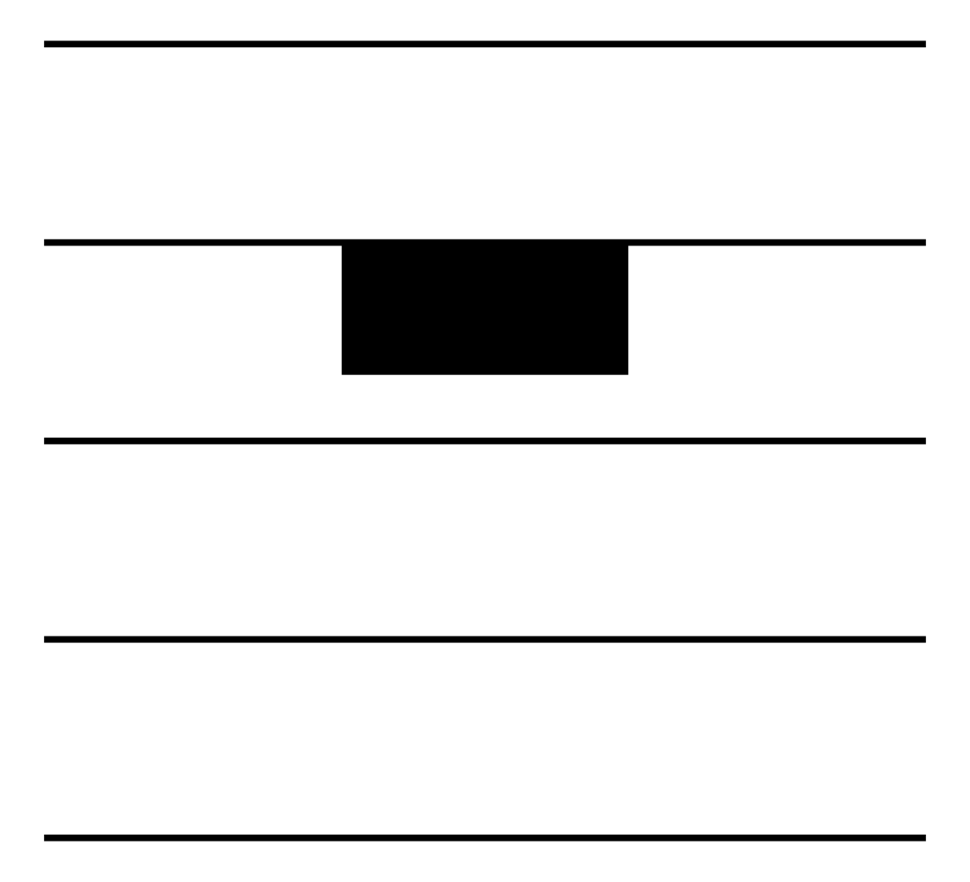

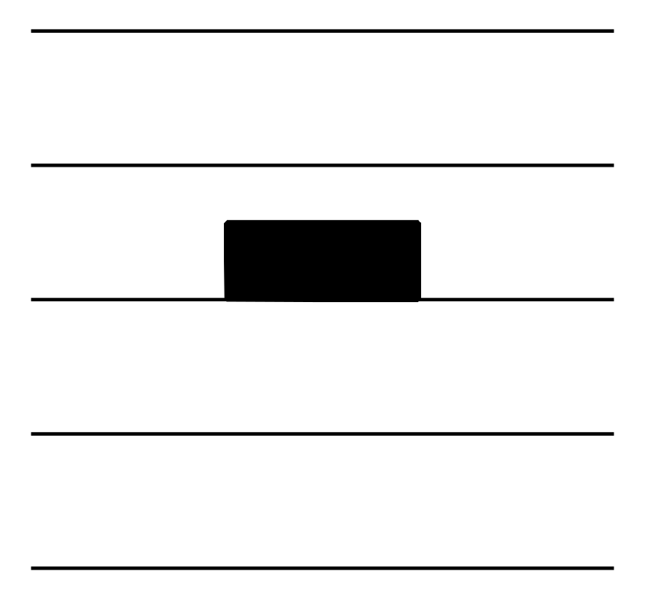

WHOLE REST INTO 2 PIECES!
What note value is each piece now?
Drag the circle onto your answer!

Slide 7
HALF REST INTO 2 PIECES!
What note value is each piece now?
Drag the circle onto your answer!

Slide 8
WHOLE REST INTO 4 PIECES!
What note value is each piece now?
Drag the circle onto your answer!

Slide 9
QUARTER REST INTO 2 PIECES!
What note value is each piece now?
Drag the circle onto your answer!

Slide 10
HALF REST INTO 4 PIECES!
What note value is each piece now?
Drag the circle onto your answer!

