Slide 1
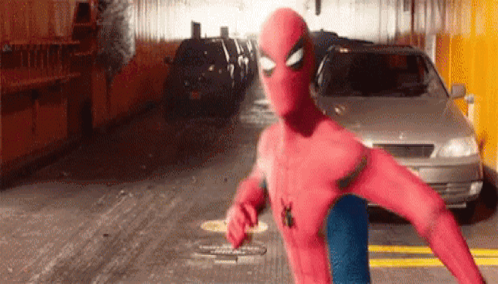
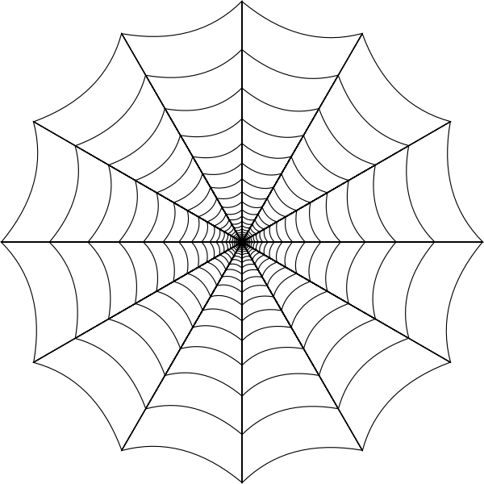





Drag the circle onto your answer!
What is the combined note value?
STUCK TOGETHER
4 QUARTER NOTES WITH HIS WEB!

Slide 2
Drag the circle onto your answer!
What is the combined note value?
STUCK TOGETHER
2 QUARTER NOTES WITH HIS WEB!

Slide 3
Drag the circle onto your answer!
What is the combined note value?
STUCK TOGETHER
2 HALF NOTES WITH HIS WEB!

Slide 4

Drag the circle onto your answer!
What is the combined note value?
STUCK TOGETHER
2 EIGHTH NOTES WITH HIS WEB!

Slide 5
Drag the circle onto your answer!
What is the combined note value?
STUCK TOGETHER
4 EIGHTH NOTES WITH HIS WEB!

Slide 6



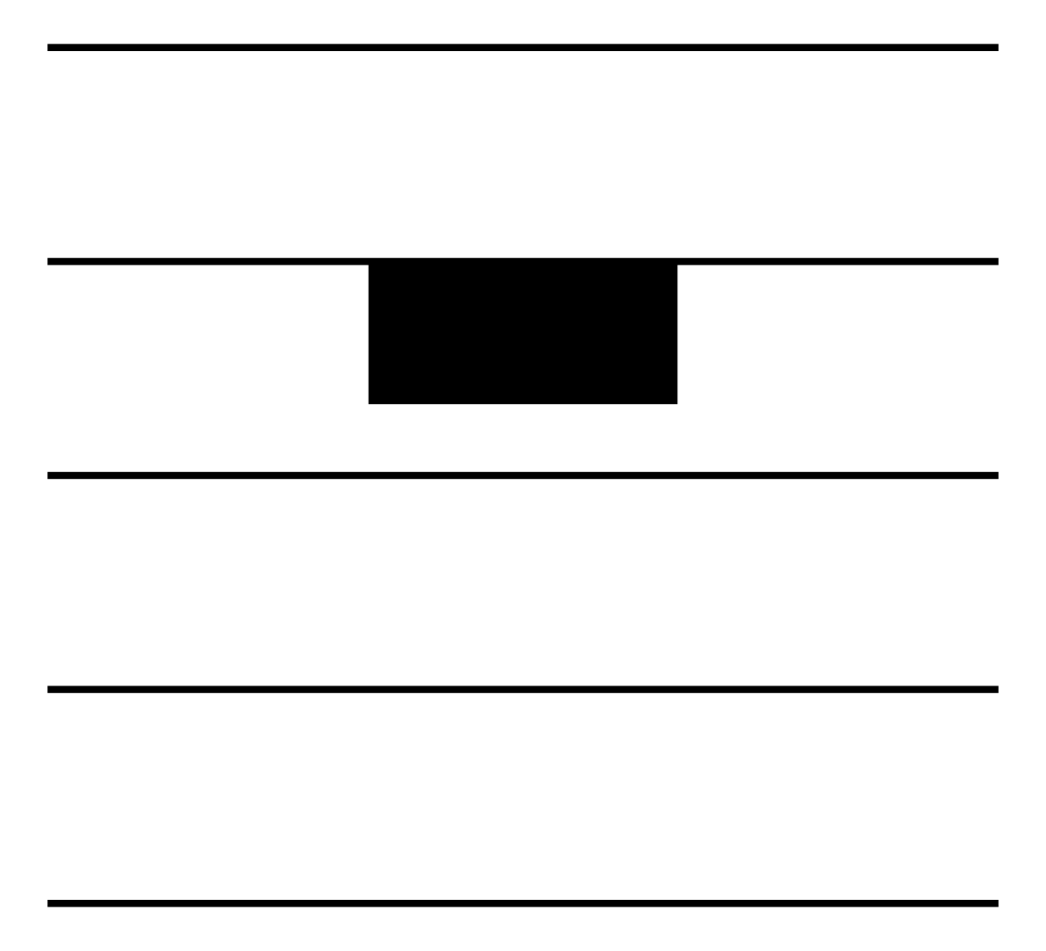
Drag the circle onto your answer!
What is the combined rest value?
STUCK TOGETHER
2 HALF RESTS WITH HIS WEB!

Slide 7
Drag the circle onto your answer!
What is the combined rest value?
STUCK TOGETHER
2 QUARTER RESTS WITH HIS WEB!

Slide 8
Drag the circle onto your answer!
What is the combined rest value?
STUCK TOGETHER
4 QUARTER RESTS WITH HIS WEB!

Slide 9
Drag the circle onto your answer!
What is the combined rest value?
STUCK TOGETHER
2 EIGHTH RESTS WITH HIS WEB!

Slide 10
Drag the circle onto your answer!
What is the combined rest value?
STUCK TOGETHER
ALL THESE RESTS WITH HIS WEB!

