Slide 1
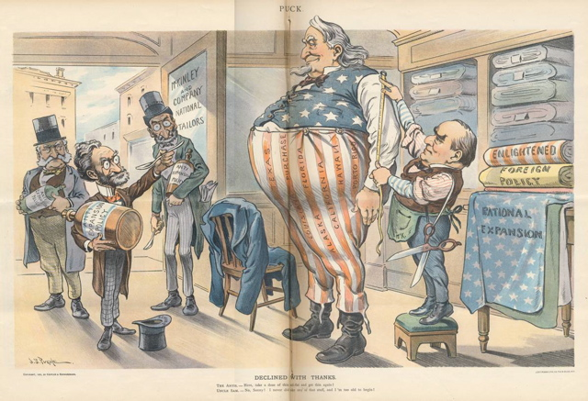
WHO AM I?
Imperialism

Slide 2
One factor which did not motivate U.S. imperialism during the late 19th and early 20th centuries was
1. Industrial Revolution 3. Naval Bases
2. Oil 4. Steam Engines

Slide 3
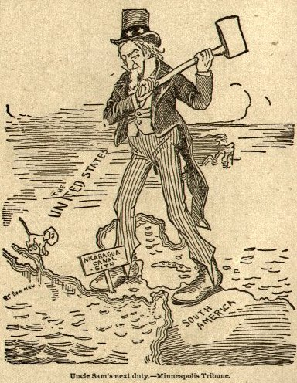
Incorrect (Try Again)

Slide 4
CORRECT!
(Go TO The Next Question)

Slide 5
I was responsible for building the Suez Canal and starting the Panama Canal
1. Ferdinand de Lesseps 3. Teddy Roosevelt
2. François Rebar 4. King Leopold

Slide 6
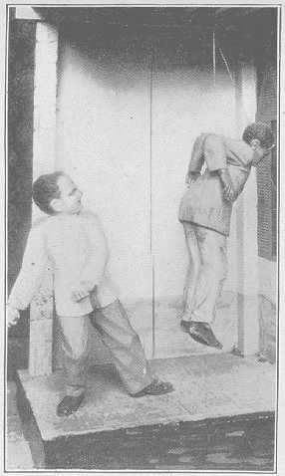
Incorrect (Try Again)

Slide 7
CORRECT!
(Go TO The Next Question)

Slide 8
I was the largest privately held colony
1. Sierra Leone
3. Liberia
2. Malawi
4. The Congo

Slide 9
Incorrect (Try Again)

Slide 10
CORRECT!
(Go TO The Next Question)

Slide 11
I was founded by the great great grandfather of Mr. Luck’s high school English Teachers Husband.
1. Zimbabwe 3. Rhodesia
2. Malawi 4. Uganda

Slide 12
Incorrect (Try Again)

Slide 13
The 19th century term “White Man’s Burden” was coined by
.
1. Mark Twain 3. Dr. Livingstone
2. Henry Stanley 4. Rudyard Kipling

Slide 14
Incorrect (Try Again)

Slide 15
The Boxer Rebellion of the early 20th century was an attempt to protect which country for foreign invaders
1. Japan 3. Vietnam
2. Korea 4. China

Slide 16
Incorrect (Try Again)

Slide 17
During the 19th century, I was divided by Europeans into Spheres of Influence
1. Africa 3. The Middle East
2. India 4. China

Slide 18
Incorrect (Try Again)

Slide 19
the Opium War (1839-1842) was fought between China and
1. Japan 3. Great Britain
2. Afghanistan 4. Persia

Slide 20
Incorrect (Try Again)

Slide 21
The Sun never set on my empire
1. United States 3. Alaska
2. Great Britain 4. Antarctica

Slide 22
Incorrect (Try Again)

Slide 23
I required the United States to Walk Softly and to Carry a Big Stick
1. William McKinley 3. William Jennings Bryan
2. Albert Schweitzer 4. Theodore Roosevelt

Slide 24
Incorrect (Try Again)

Slide 25
"I took the Canal and let Congress debate."
1. Franklin Roosevelt 3. Abraham Lincoln
2. Thomas Jefferson 4. Theodore Roosevelt

Slide 26
Incorrect (Try Again)

Slide 27
THE END

