Slide 1

DIRECTIONS:
You will discover many slides on here with different images for students to write about. Choose the one they want and you may start typing when they see START TYPING IN HERE OR ONCE UPON A TIME. Let the teacher know when you are done with your story and it may be printed out. If more slides are need for your story click on the slide your working on and click CONTROL D this will duplicate that slide. Make sure you type at the end written by and your name.
Start typing in here TYPE YOUR STORY HERE BELOW THE PICTURE YOUR LIKE1
Written by: Your name here

Slide 2
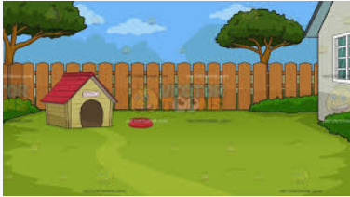
Start typing in here

Slide 3
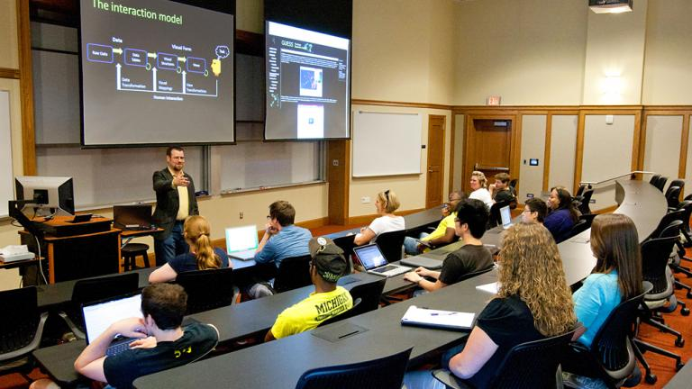
Start typing in here

Slide 4
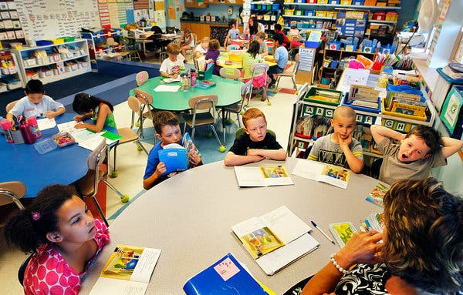
Start typing in here

Slide 5

Start typing in here

Slide 6
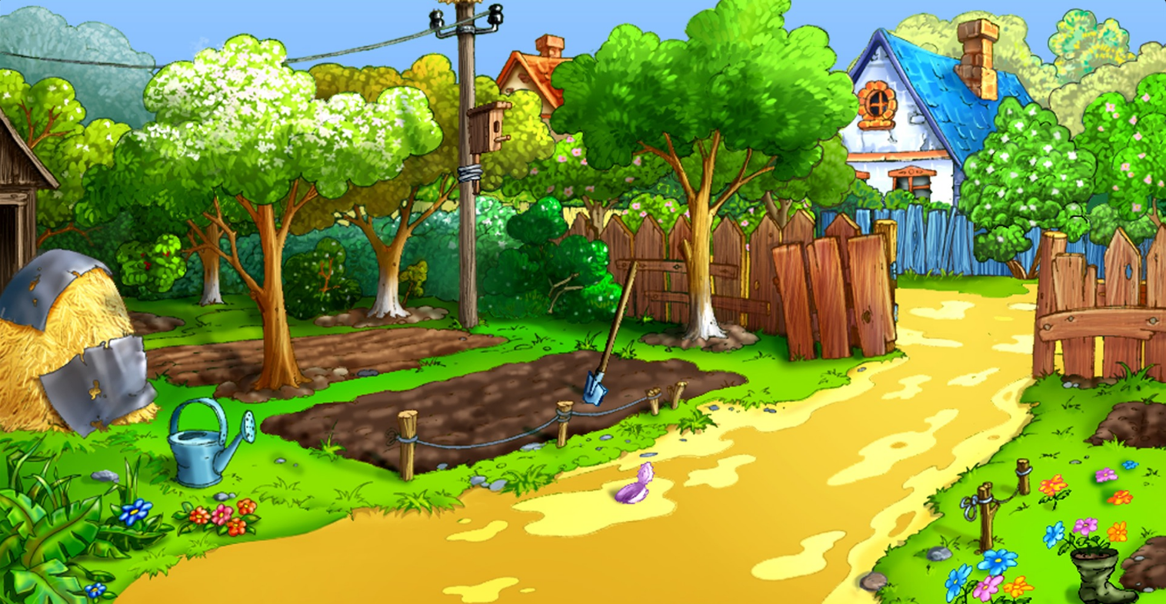
Start typing in here

Slide 7
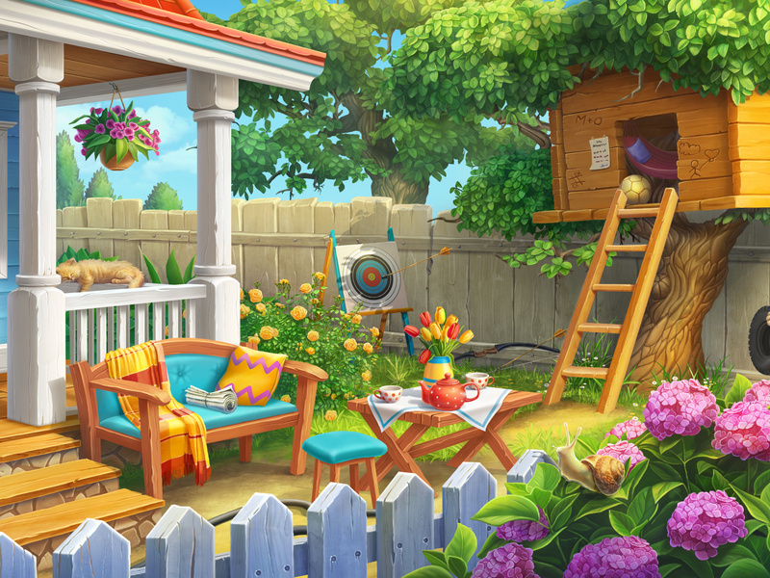
Start typing in here

Slide 8
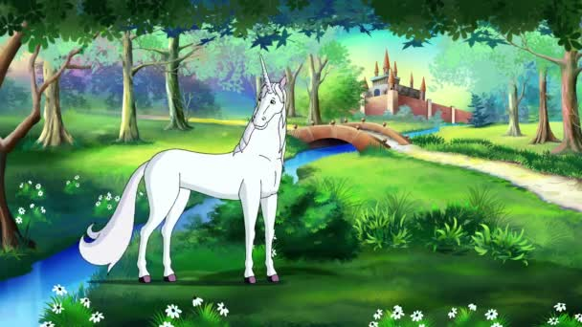
Once upon a time

Slide 9
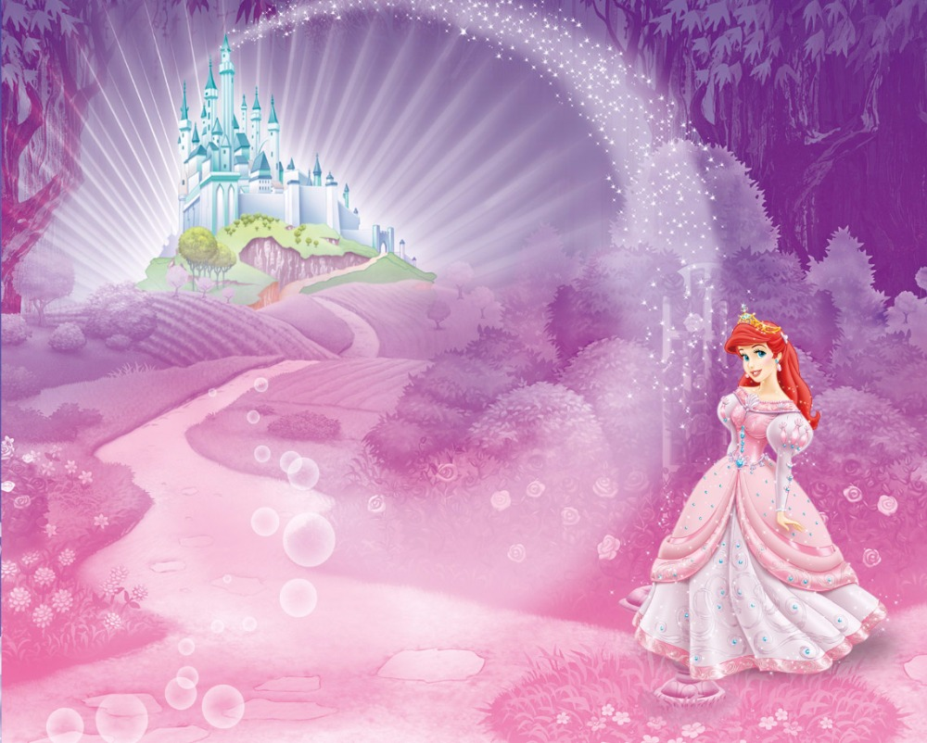
Once upon a time

Slide 10
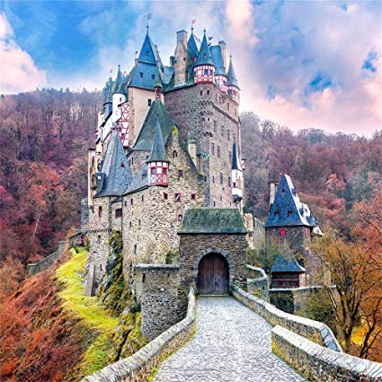
Once upon a time

Slide 11

Once upon a time

Slide 12

Once upon a time

Slide 13

Once upon a time

Slide 14


Once upon a time

Slide 15
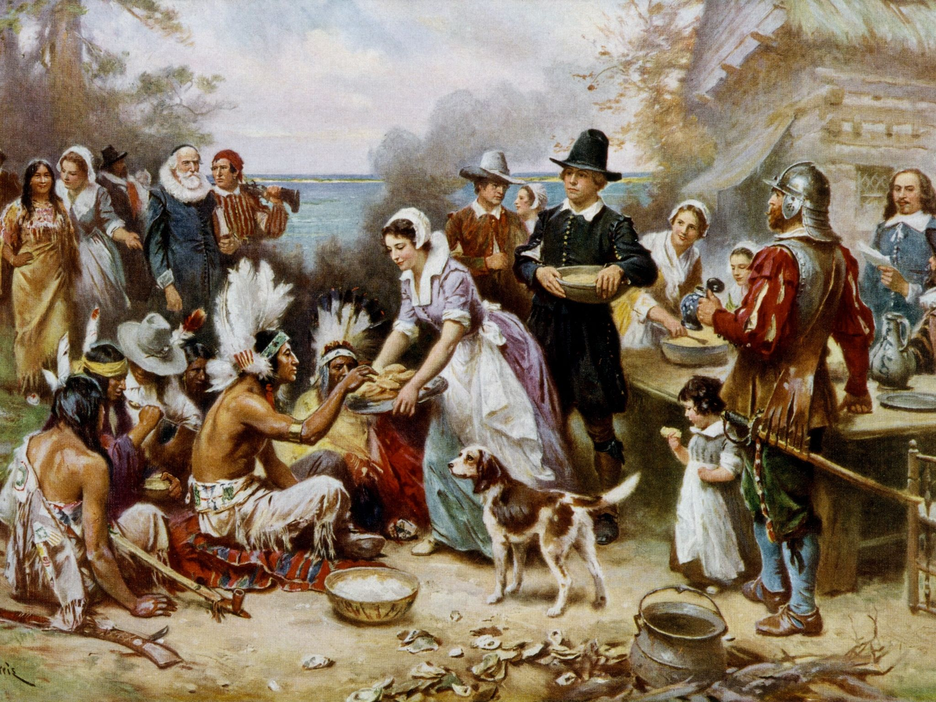
Once upon a time

Slide 16
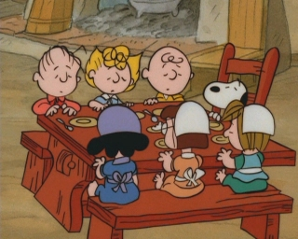
Once upon a time

Slide 17
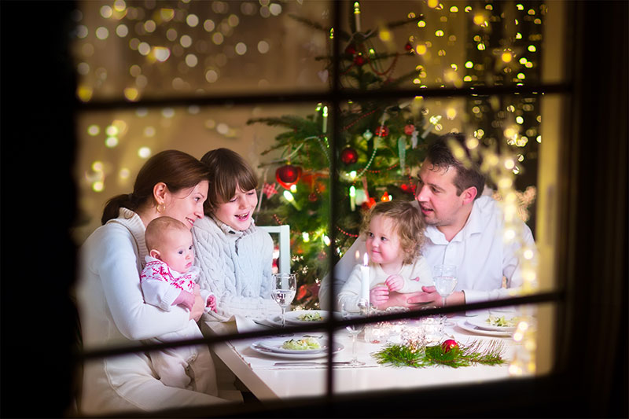
Once upon a time

Slide 18
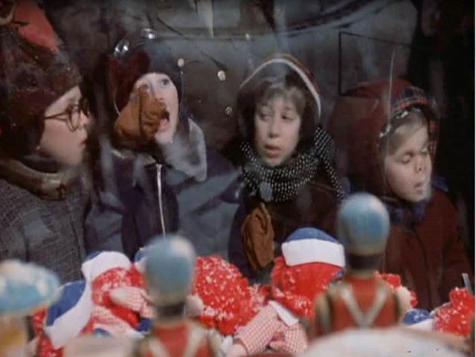
Once upon a time

Slide 19
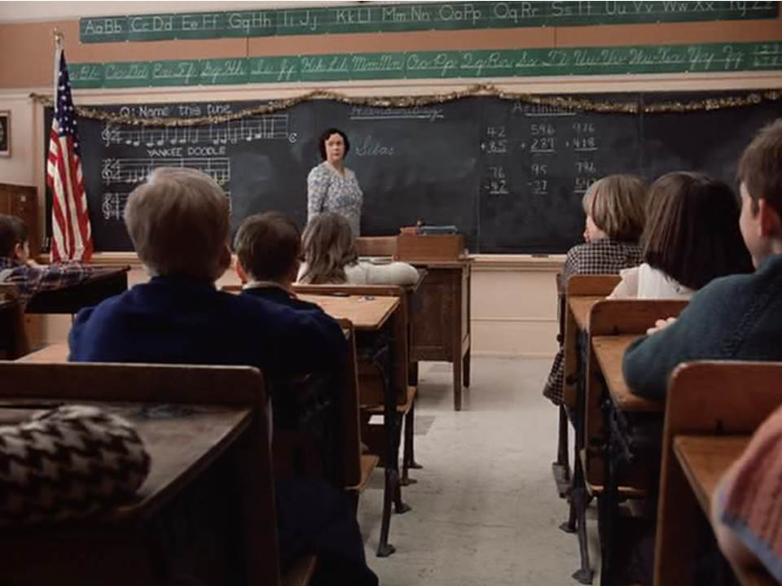
Once upon a time

Slide 20
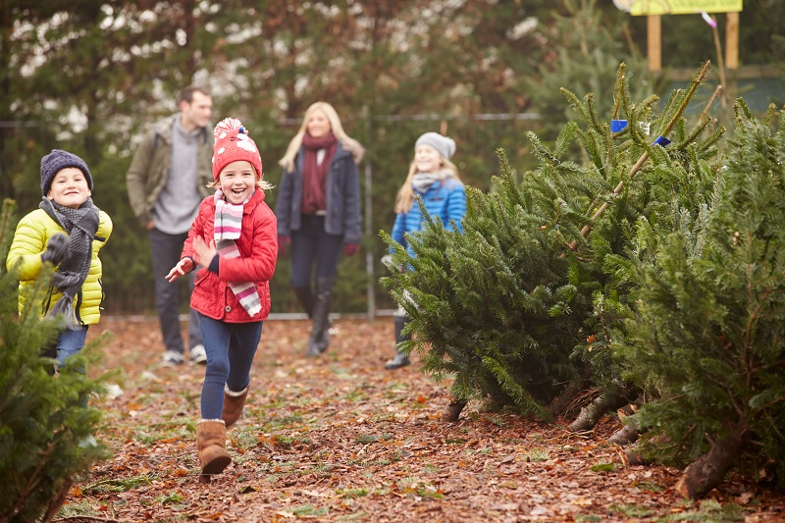
Once upon a time

Slide 21
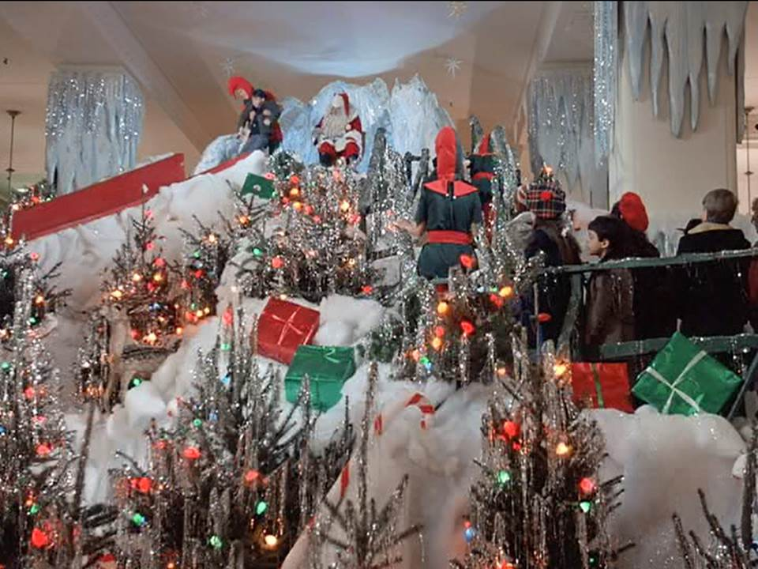
Once upon a time

Slide 22
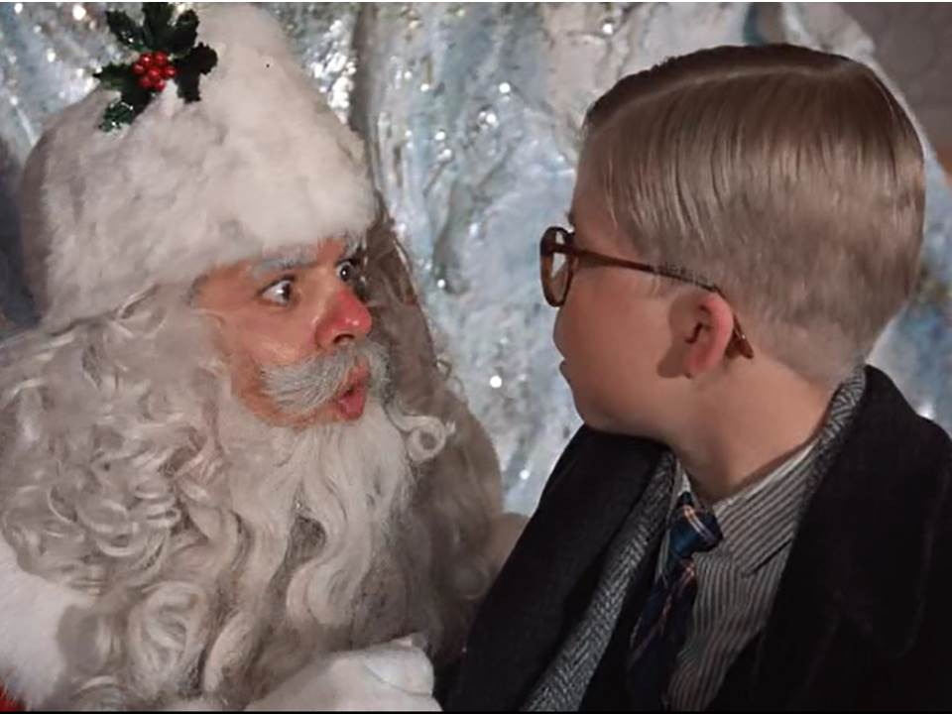
Once upon a time

