Slide 1
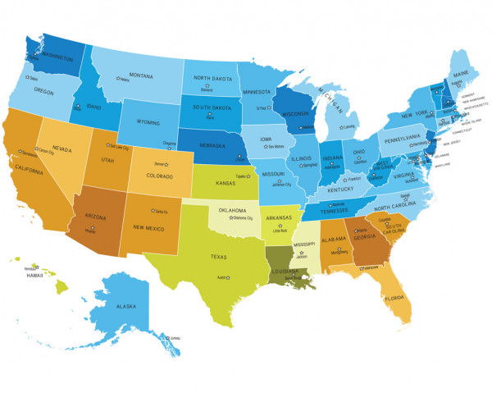
WHO AM I?
The United States of America

Slide 2

I am a state that’s in the southern part of the U.S.
1. California 3. Michigan
2. Idaho 4. Georgia

Slide 3
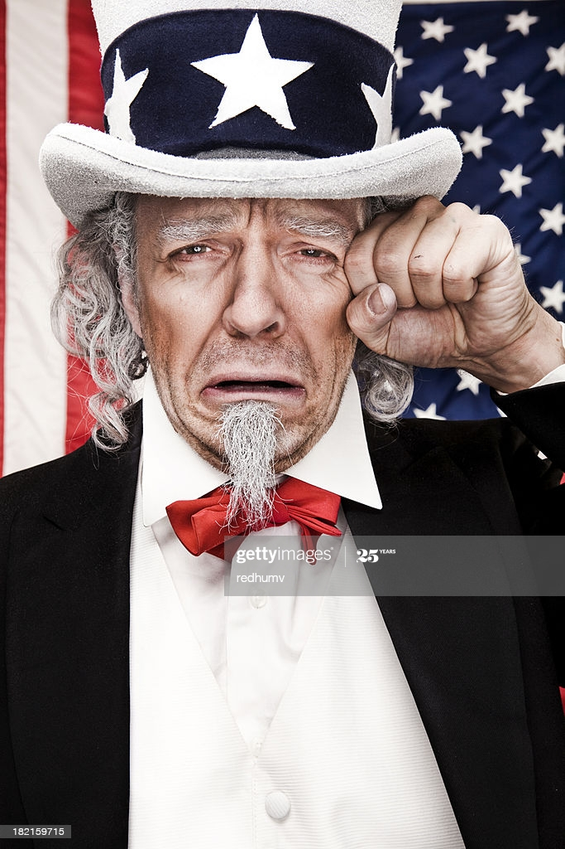
Incorrect (Try Again)

Slide 4
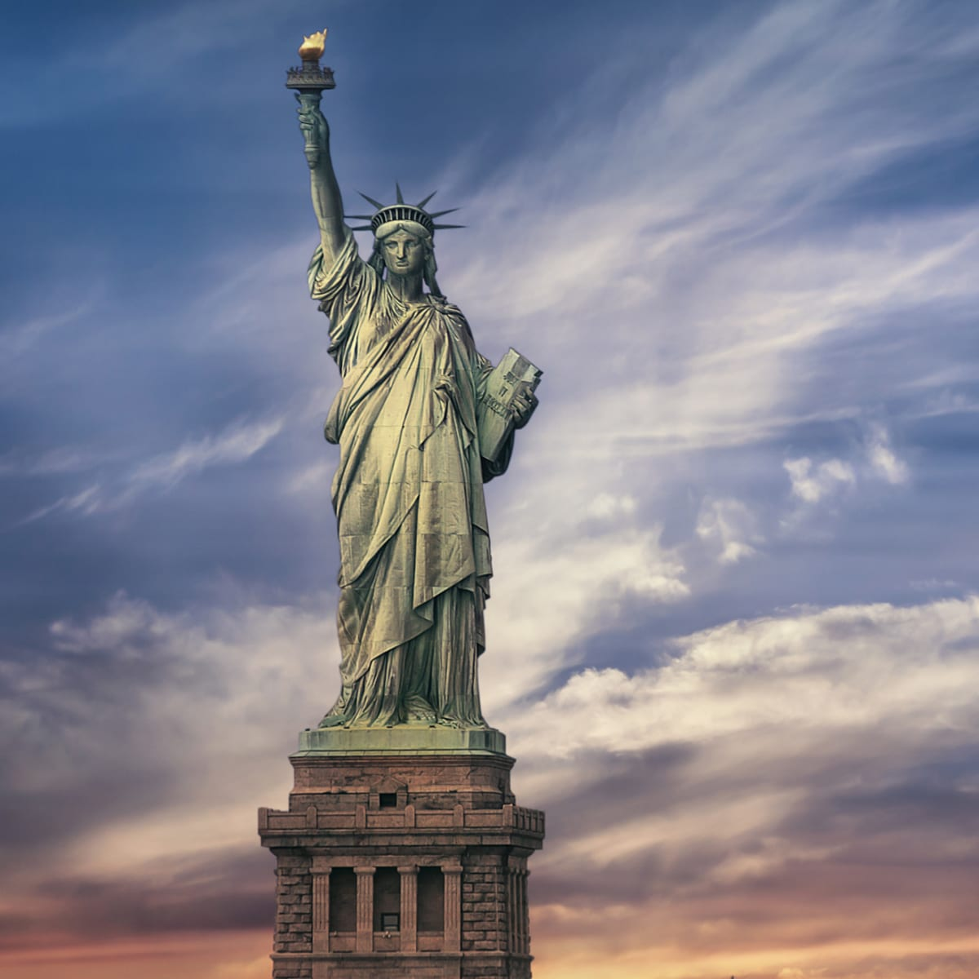
CORRECT!
(Go TO The Next Question)

Slide 5
I am a state that starts with the letter “A”
1. Arlington 3. Alabama
2. Akron 4. Aruba

Slide 6
Incorrect (Try Again)

Slide 7
CORRECT!
(Go TO The Next Question)

Slide 8
I am the country with ____ states.
1. 50 3. 35
2. 40 4. 60

Slide 9
Incorrect (Try Again)

Slide 10
CORRECT!
(Go TO The Next Question)

Slide 11
I am the state where you live.
1. New York 3. Cuyahoga
2. Ohio 4. Cleveland

Slide 12
Incorrect (Try Again)

Slide 13
CORRECT!
(Go TO The Next Question)

Slide 14
I am the state where you live.
1. New York 3. Cuyahoga
2. Ohio 4. Cleveland

Slide 15
Incorrect (Try Again)

Slide 16
CORRECT!
(Go TO The Next Question)

Slide 17
I am the state that starts with the letter “P”
1. Pennsylvania 3. Pittsburgh
2. Portsmouth 4. Painesville

Slide 18
Incorrect (Try Again)

Slide 19
CORRECT!
(Go TO The Next Question)

Slide 20
I am the state that starts with the letter “D”
1. Deepwood 3. Delaware
2. Delta 4. Dover

Slide 21
Incorrect (Try Again)

Slide 22
CORRECT!
(Go TO The Next Question)

Slide 23
I am the only state named after a President.
1. California 3. Washington
2. Michigan 4. Mississippi

Slide 24
Incorrect (Try Again)

Slide 25
CORRECT!
(Go TO The Next Question)

Slide 26
I am not a state in the U.S.
1. New England 3. New Jersey
2. New York 4. New Hampshire

Slide 27
Incorrect (Try Again)

Slide 28
CORRECT!
(Go TO The Next Question)

Slide 29
I am the largest state in the U.S.
1. Texas 3. Utah
2. Alaska 4. Nevada

Slide 30
Incorrect (Try Again)

Slide 31
CORRECT!
(Go TO The Next Question)

Slide 32
I am the smallest state in the U.S.
1. Connecticut 3. Arizona
2. Vermont 4. Rhode Island

Slide 33
Incorrect (Try Again)

Slide 34
CORRECT!
(Go TO The Next Question)

Slide 35

THE END

