Slide 1




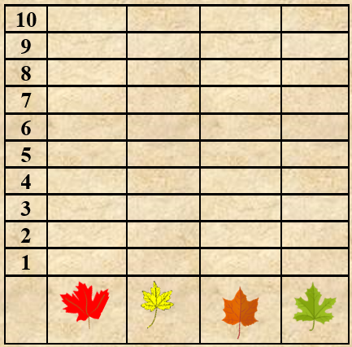

Directions: Click on a leaf and then Control Key and the letter D to duplicate that leaf. Do this as many times as you want. Place the leaves on the tree then adjust the black line as long and as short as you want by clicking on the top of it and adjusting it for the graph.

Slide 2

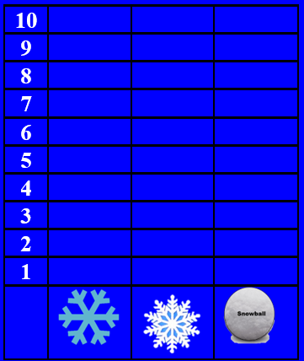


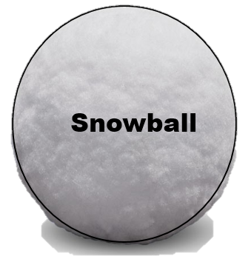
Directions: Click on a snow flake or snowball and then Control Key and the letter D to duplicate that flake or snowball. Do this as many times as you want. Place the objects on the picture then adjust the white line as long and as short as needed by clicking on the top of the line and adjusting it for the correct length for the graph.

Slide 3
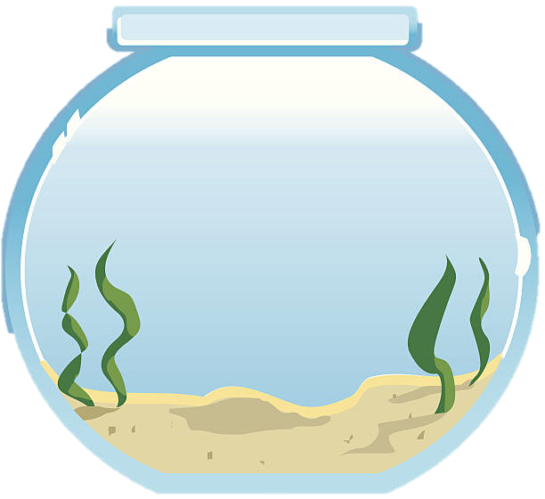
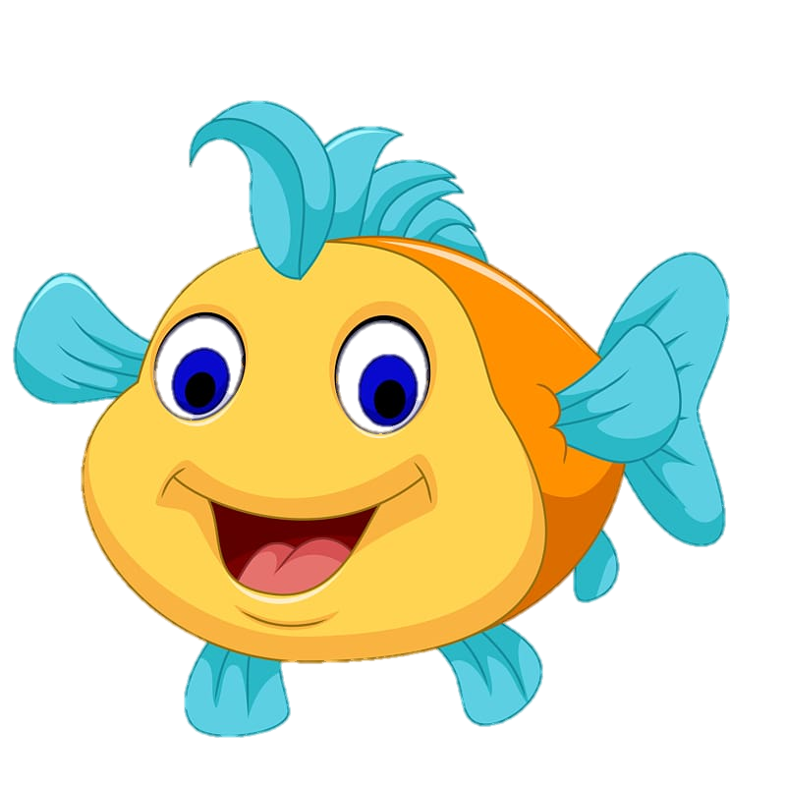
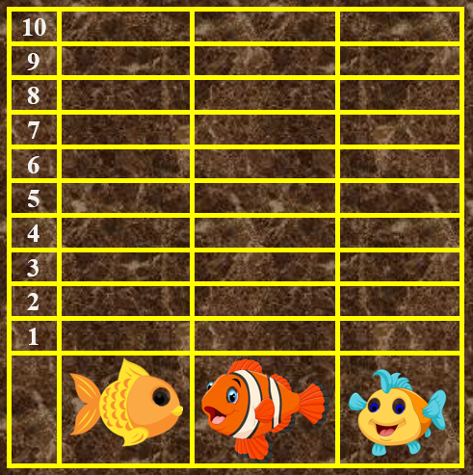
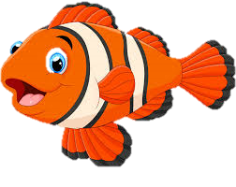

Directions: Click on a fish and then Control Key and the letter D to duplicate that Fish. Do this as many times as you want. Place the fish in the bowl then adjust the white line as long and as short as you want by clicking on the top of it and adjusting it for the graph.

Slide 4
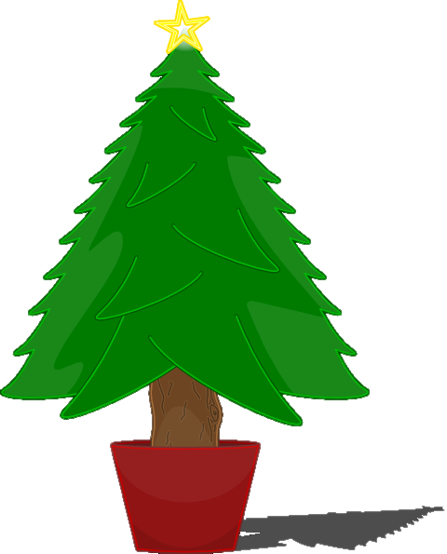
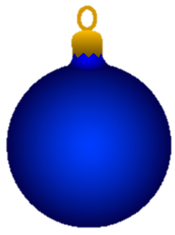
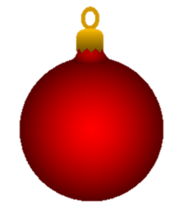
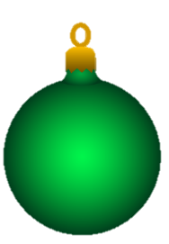
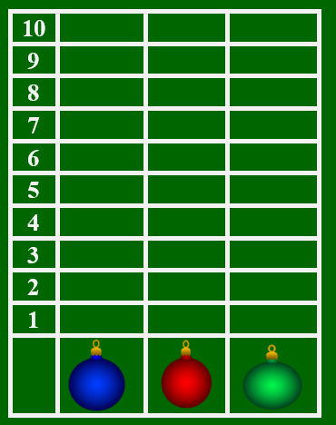
Directions: Click on an ordainment and then Control Key and the letter D to duplicate that ordainment. Do this as many times as you want. Place the ordainment in the tree then adjust the white line as long and as short as you want by clicking on the top of it and adjusting it for the graph.

