Slide 1

Comparing Integers

Slide 2
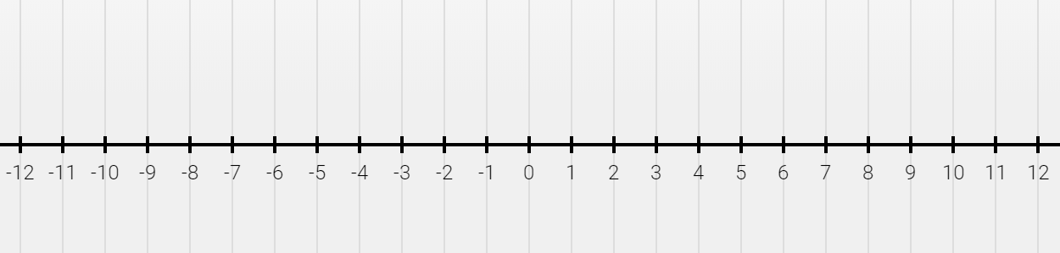
Comparing Integers Using a Number Line
As numbers move the right, they get larger. As numbers move to the left, they get smaller.
When comparing -7 and 3, we see the 3 is farther to the right, so it is larger than -7.

Slide 3

Let’s try comparing!
Slide the red circle over your answer.
Which integer is LARGER?
-10 or 6

Slide 4
Let’s try comparing!
Slide the red circle over your answer.
Which integer is SMALLER?
-5 or -4

Slide 5
Comparing Integers Using a Number Line
We can use these comparison symbols to compare integers as well.
> greater than
< less than
= equal
We can compare these integers this way:
-7 < 3

Slide 6
Let’s try comparing!
Which symbol makes this true?
-2 ____ -5
>
>

Slide 7
Let’s try comparing!
Which symbol makes this true?
-10 ____ 8
>
>

Slide 8
Let’s try comparing!
Which symbol makes this true?
1 ____ -4
>
>

Slide 9


Ordering
Integers

Slide 10

Using the Number Line
Place the integers on the number line at the correct spot.
Remember: Numbers are smaller as you move the left and larger as you move to the right
Write the numbers in order.

Slide 11

Order from least to greatest:
-5, 3, -7, 6, 0
Example Slide
-7, -5, 0, 3, 6

Slide 12
Order from least to greatest:
-3, 4, -6, 2, 0
Grab a dot to graph the integers
Type answer here

Slide 13
Order from greatest to least:
11, -7, 0, -12, -10
Grab a dot to graph the integers
Type answer here

Slide 14

Turn this in on Google Classroom

