Slide 1

Graphing Ratio Tables
Your family travels 80 miles in 2 hours. At this rate, how far do you travel in 5 hours?

Slide 2

How do you graph ratio tables?
Step 1: Write the rate as a fraction and find the unit rate.
Your family travels 80 miles in 2 hours. At this rate, how far do you travel in 5 hours?

Slide 3

How do you graph ratio tables?
Step 2: Fill in the table with equivalent rates using multiplication or division. Be sure to multiply or divide both quantities by the same value.
Hours (x) | 1 | 2 | 3 | 4 | 5
Miles (y) | 40 | 80

Slide 4
How do you graph ratio tables?
Hours (x) | Miles (y)
1 | 40
2 | 80
3 | 120
4 | 160
5 | 200
Step 3: Use the values from the ratio table to make a set of ordered pairs.
(x, y)

Slide 5
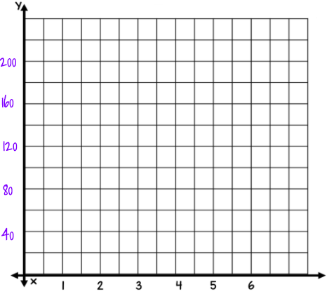
How do you graph ratio tables?
Hours (x) | Miles (y)
1 | 40
2 | 80
3 | 120
4 | 160
5 | 200
Step 4: Plot the ordered pairs on the graph.
Grab a dot to plot on the graph

Slide 6
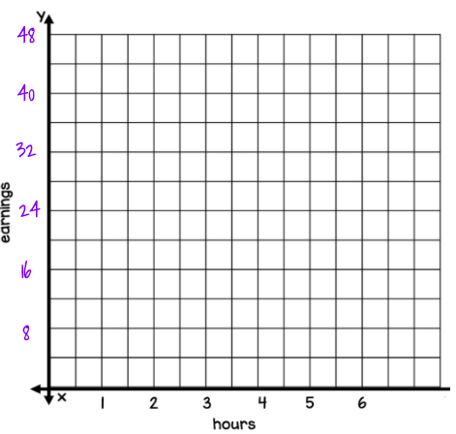
Let’s Try it! #1
Ryan worked 2 hours raking leaves. He earned $16. At this rate, how much would he earn in 5 hours of work?
Hours (x) | Earnings (y)
1
2 | $16
3
4
5
Grab a dot to plot on the graph

Slide 7
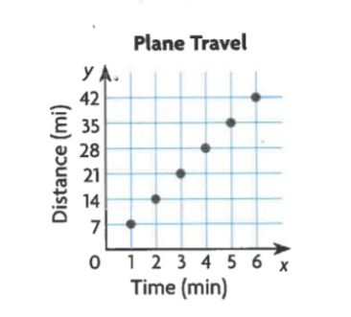
#2
The graph shows the distance that a plane flying at a steady rate travels over time.
Use equivalent ratios to find how far the plane travels in 13 minutes.
Type answer here.

Slide 8
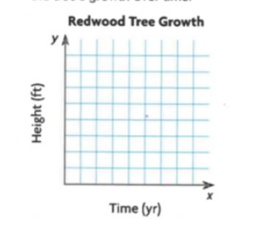
#3
A redwood tree grew at a rate of 4 feet per year.
Use equivalent ratios to complete the chart and then graph the tree’s growth over time.
Height (feet)
Time (year) | 1 | 2
Grab a dot to plot on the graph

Slide 9
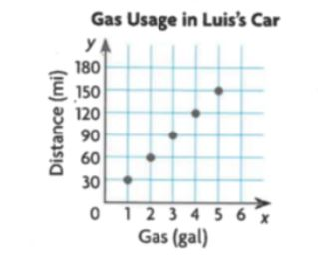
#4
The graph shows the rate at which Luis’s car uses gas, in miles per gallon. Use the graph to complete the table and answer the questions on this slide.
Distance (miles) | 30
Gas (gallons) | 1 | 2 | 3 | 4 | 5
Estimate the amount of gas needed to travel 50 miles.
Find the car’s unit rate.
Type answer here
Type answer here
How far can the car go on 5 gallons of gas?
Type answer here

Slide 10
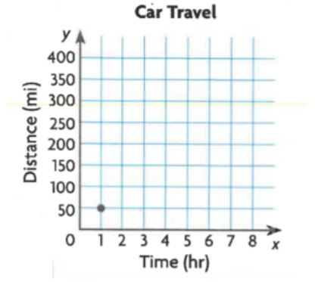
#5
A car travels at a rate of 50 miles per hour. Use equivalent ratios to complete the chart and then graph the distance the car travels over time.
Distance (miles) | 50 |  | 150 | 200
Time (hour) | 1 | 2 |  |  | 5
Grab a dot to plot on the graph

