Slide 1
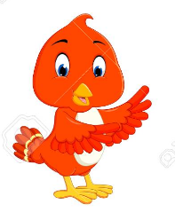



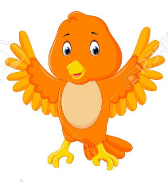
Color # of
Birds Birds
RED 3
GREEN 4
BLUE 2
YELLOW 3
ORANGE 5
RED
GREEN
BLUE
YELLOW
ORANGE

