Slide 1
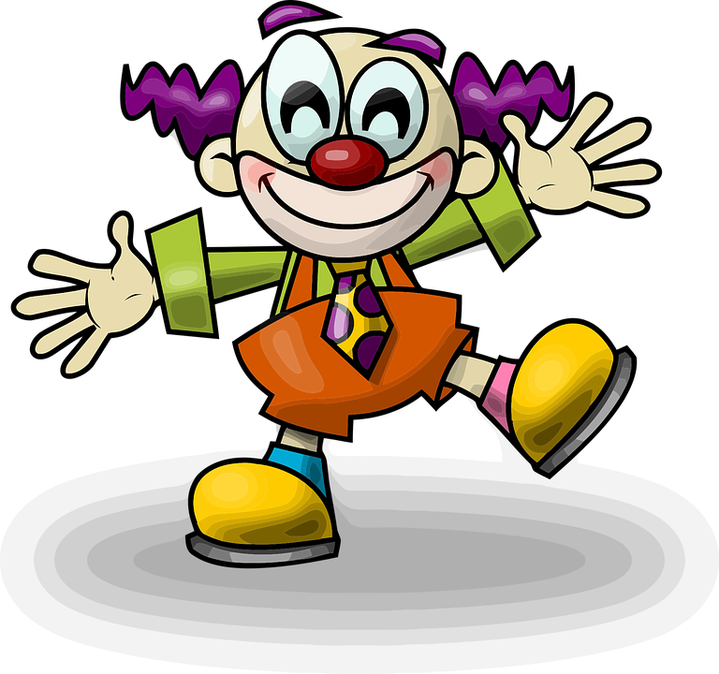
Subitizing
Dots Clown
DIRECTIONS:
Click & Drag Game
Find the pattern that is equal to the number.
Owner: Betsy Sankovich

Slide 2
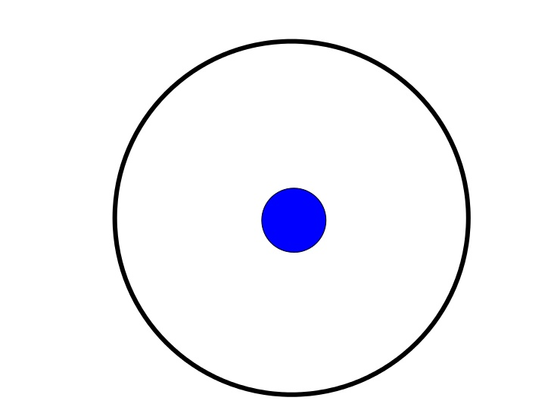
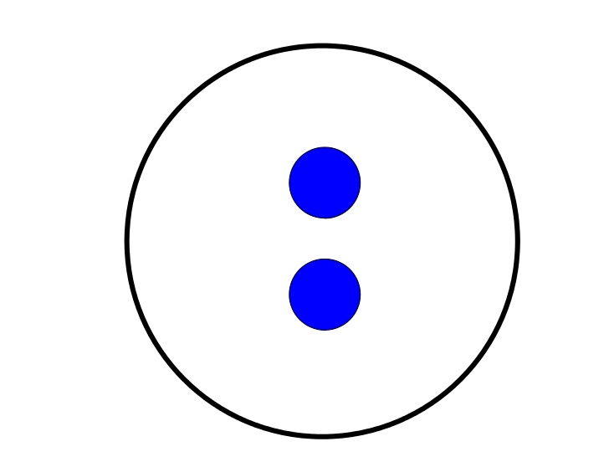
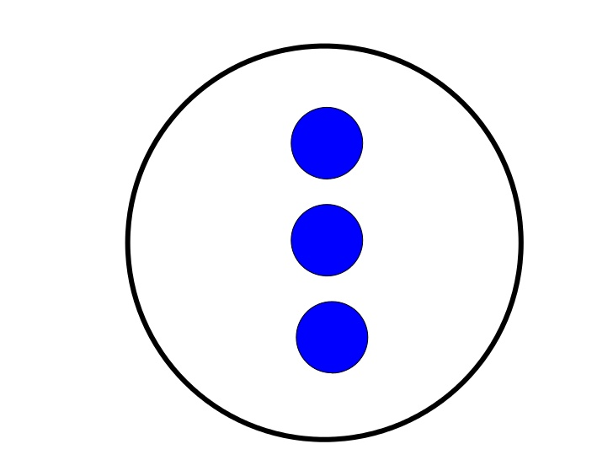
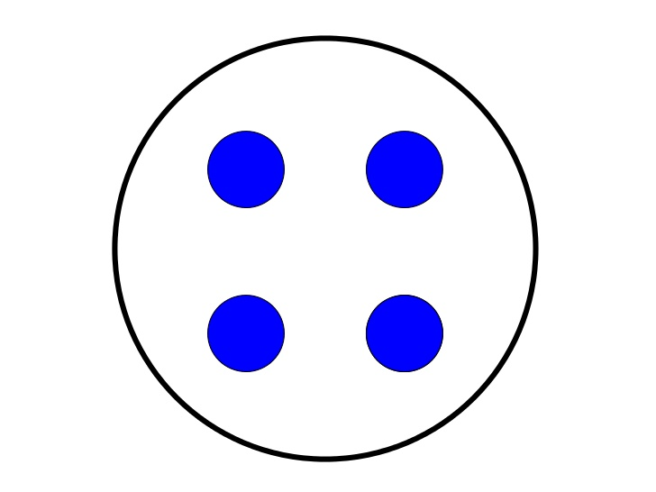
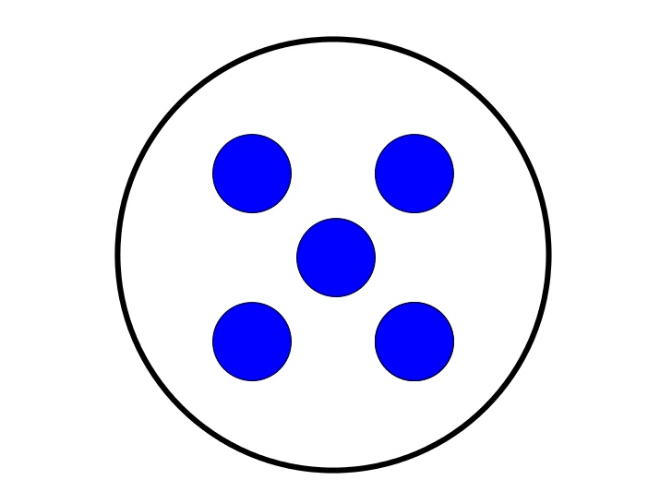
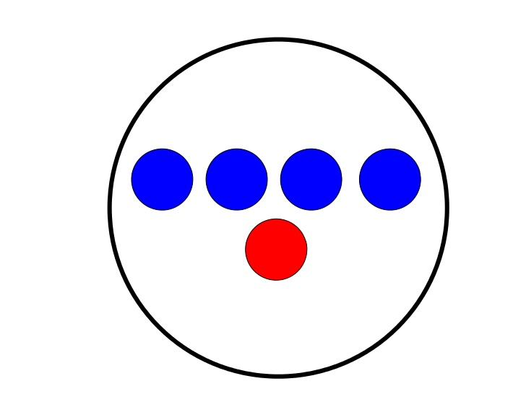
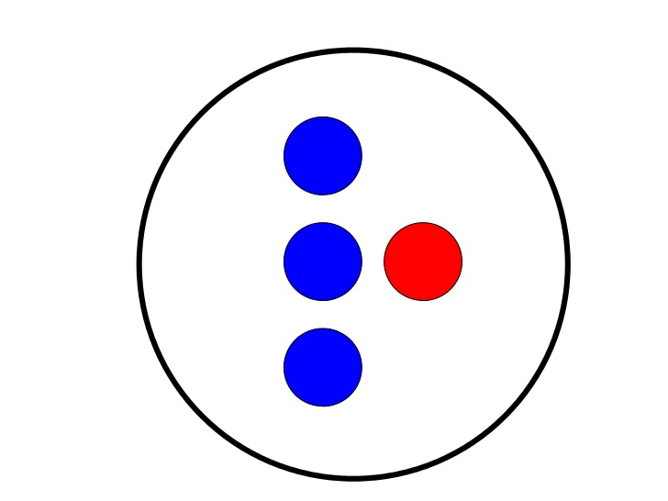



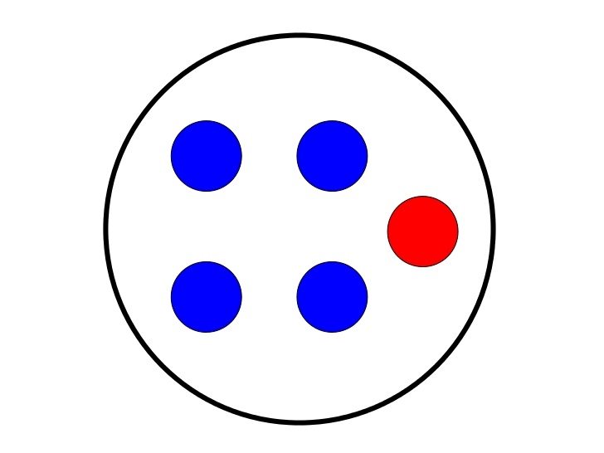
Subitizing Dot Practice
1
2
3
4
5

Slide 3
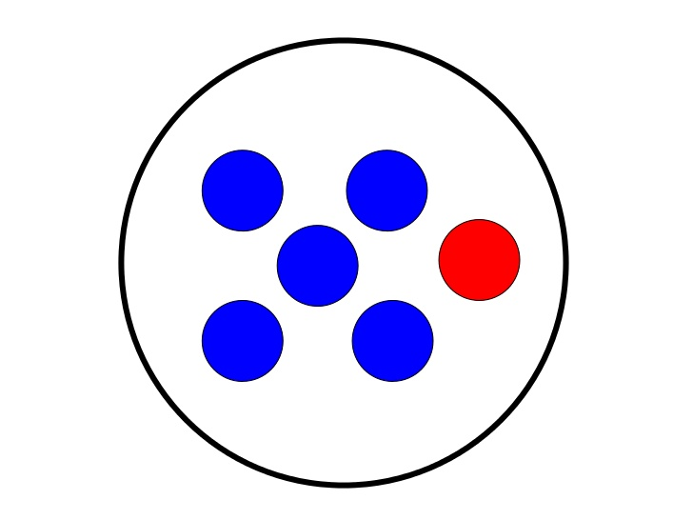
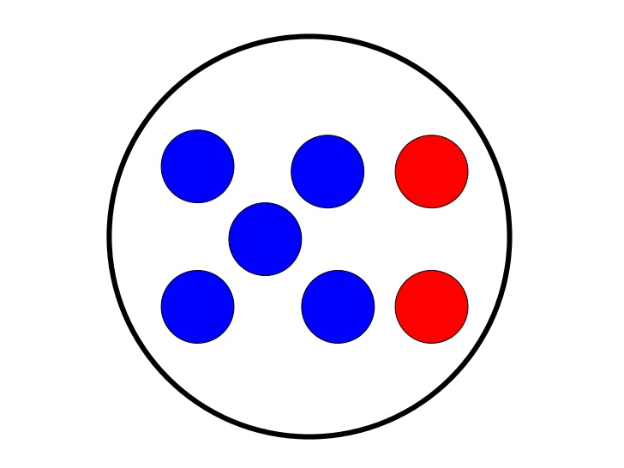
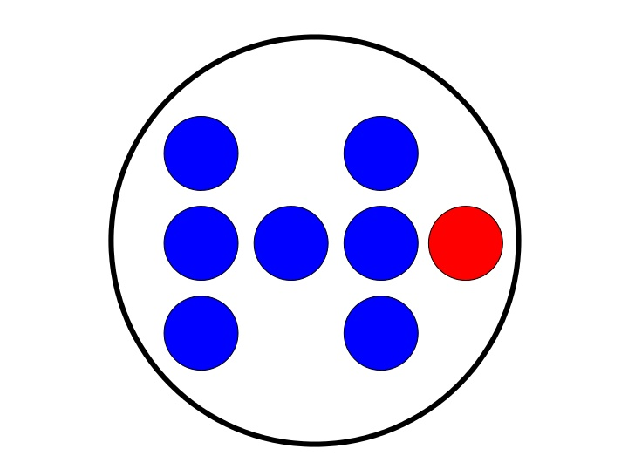
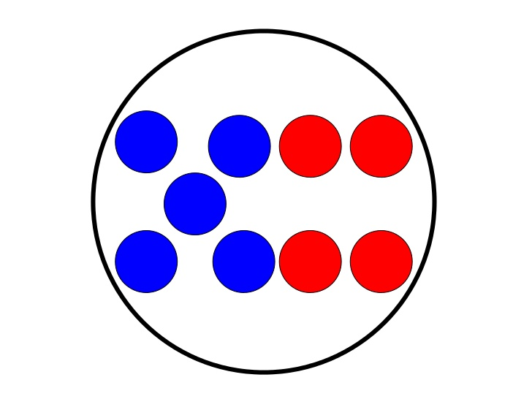
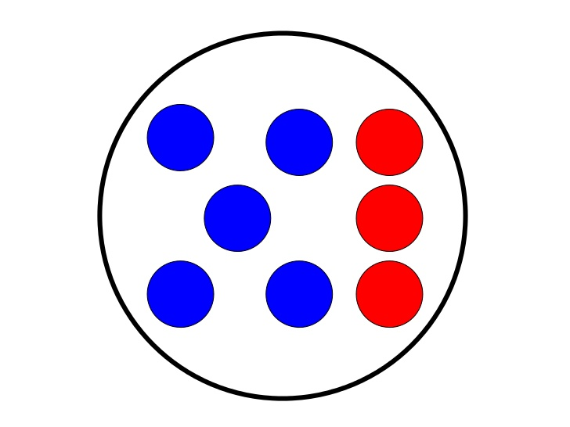
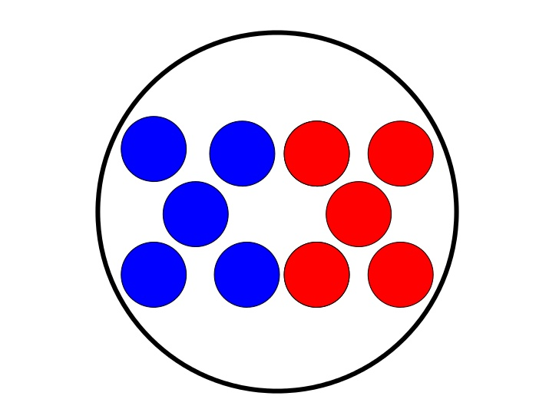
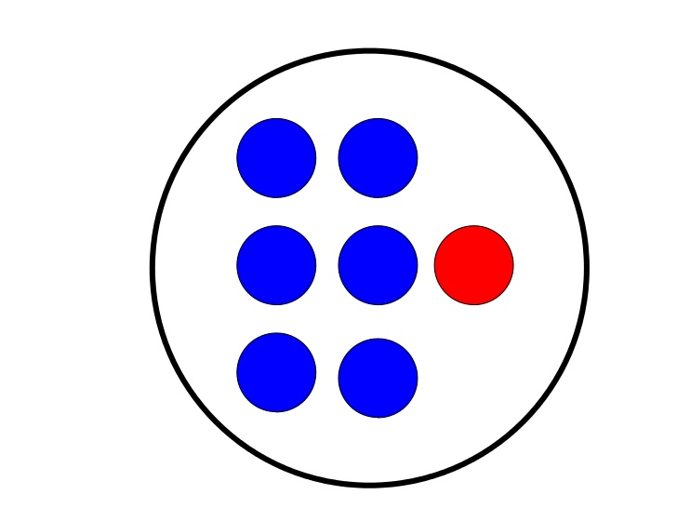

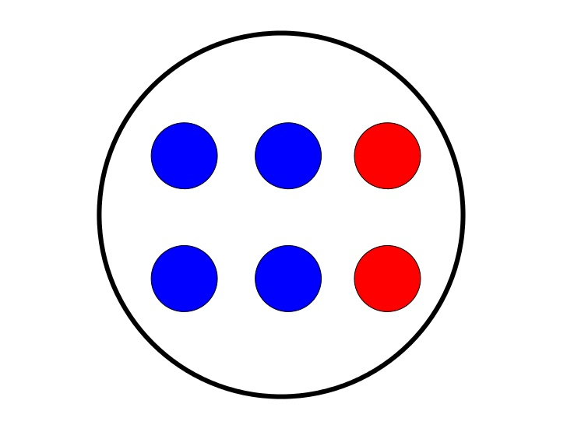

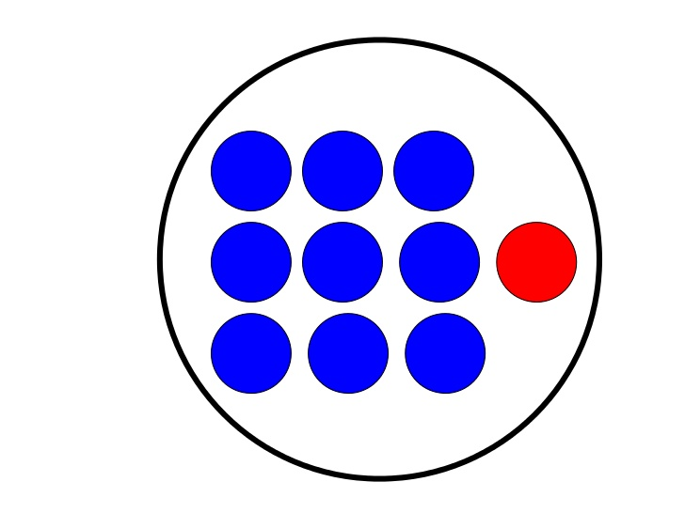
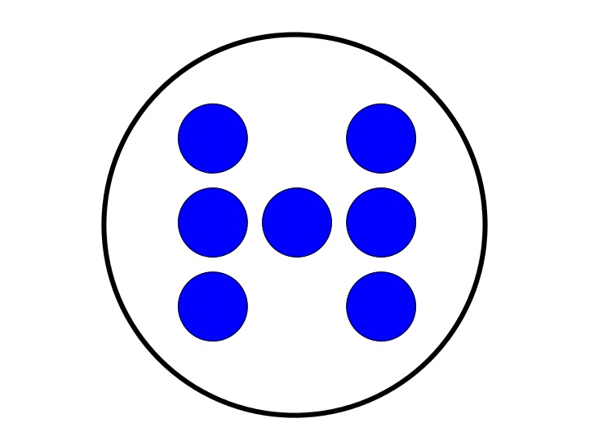

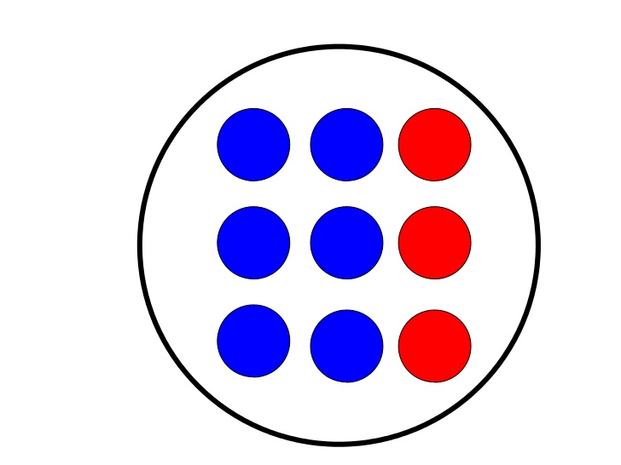




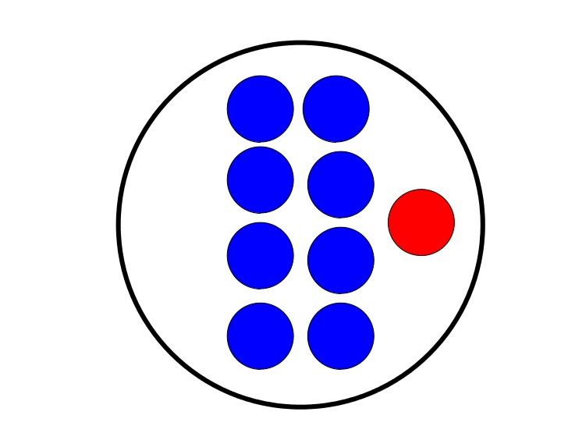

Subitizing Dot Practice
6
7
8
9
10

Slide 4
DIRECTIONS:
Click & Drag Game
Find the pattern that is equal to the number.
5

Slide 5
DIRECTIONS:
Click & Drag Game
Find the pattern that is equal to the number.
3

Slide 6
DIRECTIONS:
Click & Drag Game
Find the pattern that is equal to the number.
6

Slide 7
DIRECTIONS:
Click & Drag Game
Find the pattern that is equal to the number.
4

Slide 8
DIRECTIONS:
Click & Drag Game
Find the pattern that is equal to the number.
7

Slide 9
DIRECTIONS:
Click & Drag Game
Find the pattern that is equal to the number.
10

Slide 10
DIRECTIONS:
Click & Drag Game
Find the pattern that is equal to the number.
8

Slide 11
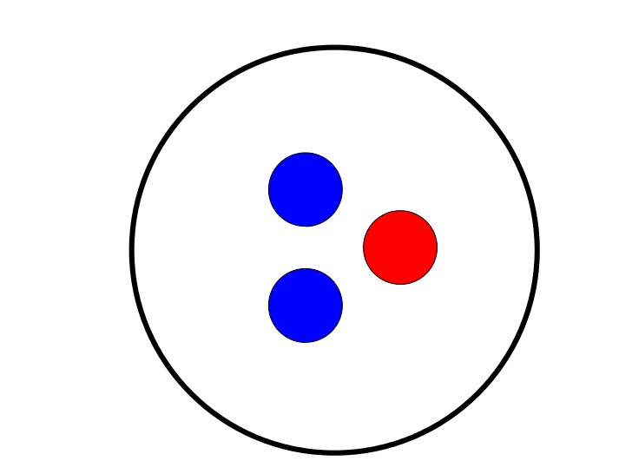
DIRECTIONS:
Click & Drag Game
Find the pattern that is equal to the number.
1

Slide 12
DIRECTIONS:
Click & Drag Game
Find the pattern that is equal to the number.
9

Slide 13
DIRECTIONS:
Click & Drag Game
Find the pattern that is equal to the number.
2

Slide 14
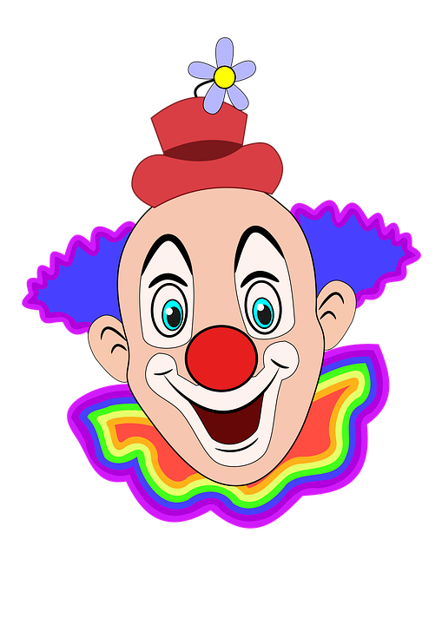

The End
Great Job!
Remember to return to Mrs. Sankovich

