Slide 1

Math Game #2
Subtracting
Fish
#6-#7-#8
Owner: Betsy Sankovich
Directions:
Read the equation and put an “X” on the fish to be taken away. Type in your answer.

Slide 2


Directions:
Read the equation and put an “X” on the fish to be taken away. Type in your answer.
SAMPLE
Subtracting Fish
6
3
3

Slide 3

Directions:
Read the equation and put an “X” on the fish to be taken away. Type in your answer.
Subtracting Fish
6
0

Slide 4

Directions:
Read the equation and put an “X” on the fish to be taken away. Type in your answer.
Subtracting Fish
7
3

Slide 5

Directions:
Read the equation and put an “X” on the fish to be taken away. Type in your answer.
Subtracting Fish
8
2

Slide 6

Directions:
Read the equation and put an “X” on the fish to be taken away. Type in your answer.
Subtracting Fish
6
1

Slide 7

Directions:
Read the equation and put an “X” on the fish to be taken away. Type in your answer.
Subtracting Fish
7
4

Slide 8

Directions:
Read the equation and put an “X” on the fish to be taken away. Type in your answer.
Subtracting Fish
7
2

Slide 9

Directions:
Read the equation and put an “X” on the fish to be taken away. Type in your answer.
Subtracting Fish
6
5

Slide 10

Directions:
Read the equation and put an “X” on the fish to be taken away. Type in your answer.
Subtracting Fish
8
1

Slide 11

Directions:
Read the equation and put an “X” on the fish to be taken away. Type in your answer.
Subtracting Fish
6
2

Slide 12

Directions:
Read the equation and put an “X” on the fish to be taken away. Type in your answer.
Subtracting Fish
8
4

Slide 13

Directions:
Read the equation and put an “X” on the fish to be taken away. Type in your answer.
Subtracting Fish
6
3

Slide 14

Directions:
Read the equation and put an “X” on the fish to be taken away. Type in your answer.
Subtracting Fish
7
0

Slide 15

Directions:
Read the equation and put an “X” on the fish to be taken away. Type in your answer.
Subtracting Fish
6
4

Slide 16
Directions:
Read the equation and put an “X” on the fish to be taken away. Type in your answer.
Subtracting Fish
8
0

Slide 17

Directions:
Read the equation and put an “X” on the fish to be taken away. Type in your answer.
Subtracting Fish
8
3

Slide 18

Directions:
Read the equation and put an “X” on the fish to be taken away. Type in your answer.
Subtracting Fish
7
1

Slide 19

Directions:
Read the equation and put an “X” on the fish to be taken away. Type in your answer.
Subtracting Fish
7
6

Slide 20

Directions:
Read the equation and put an “X” on the fish to be taken away. Type in your answer.
Subtracting Fish
8
5

Slide 21

Directions:
Read the equation and put an “X” on the fish to be taken away. Type in your answer.
Subtracting Fish
7
5

Slide 22

Directions:
Read the equation and put an “X” on the fish to be taken away. Type in your answer.
Subtracting Fish
6
3

Slide 23

Directions:
Read the equation and put an “X” on the fish to be taken away. Type in your answer.
Subtracting Fish
7
7

Slide 24
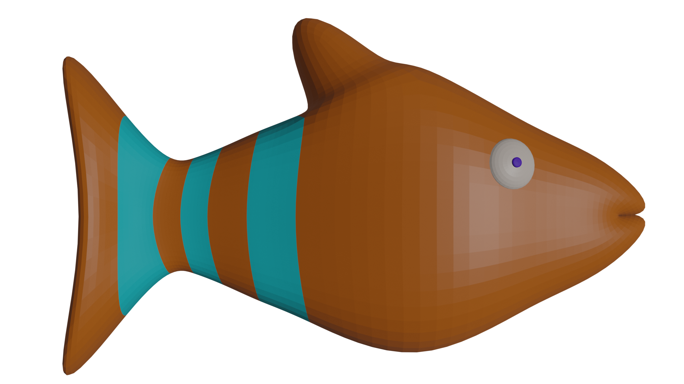
Directions:
Read the equation and put an “X” on the fish to be taken away. Type in your answer.
Subtracting Fish
8
6

Slide 25



The
End!
Remember to send back to Mrs. Sankovich
Awesome
Job!

