Slide 1
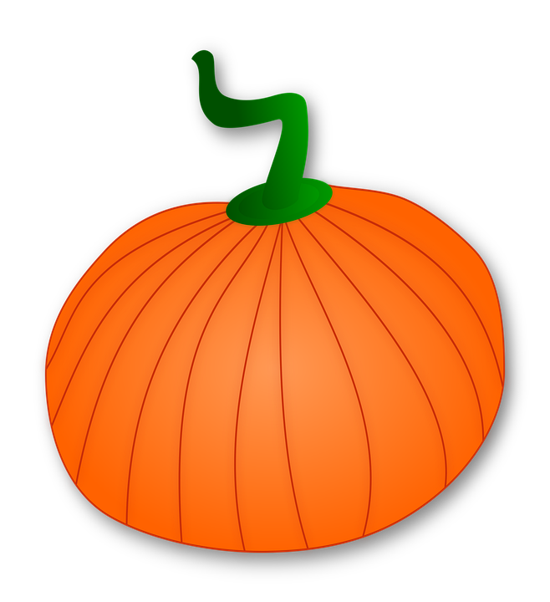
Pumpkin Patch Addition
Directions: Compare each picture with the addition sentence, then count and type the total in the square.

Slide 2
Directions: Compare each picture with the addition sentence, then count and type the total in the square.
7 + 1 =
Notes:
Compare each picture with the addition sentence, then count and type the total in the square.

Slide 3
Directions: Compare each picture with the addition sentence, then count and type the total in the square.
6 + 3 =
Notes:
Compare each picture with the addition sentence, then count and type the total in the square.

Slide 4
Directions: Compare each picture with the addition sentence, then count and type the total in the square.
5 + 4 =
Notes:
Compare each picture with the addition sentence, then count and type the total in the square.

Slide 5
Directions: Compare each picture with the addition sentence, then count and type the total in the square.
8 + 2 =
Notes:
Compare each picture with the addition sentence, then count and type the total in the square.

Slide 6
Directions: Compare each picture with the addition sentence, then count and type the total in the square.
7 + 3 =
Notes:
Compare each picture with the addition sentence, then count and type the total in the square.

Slide 7
Directions: Compare each picture with the addition sentence, then count and type the total in the square.
7 + 2 =
Notes:
Compare each picture with the addition sentence, then count and type the total in the square.

Slide 8
Directions: Compare each picture with the addition sentence, then count and type the total in the square.
5 + 5 =
Notes:
Compare each picture with the addition sentence, then count and type the total in the square.

Slide 9
Directions: Compare each picture with the addition sentence, then count and type the total in the square.
2 + 7 =
Notes:
Compare each picture with the addition sentence, then count and type the total in the square.

Slide 10
Directions: Compare each picture with the addition sentence, then count and type the total in the square.
4 + 5 =
Notes:
Compare each picture with the addition sentence, then count and type the total in the square.

