Slide 1
EARLY CAuses of the American Revolution
Mrs. Vuraich

Slide 2
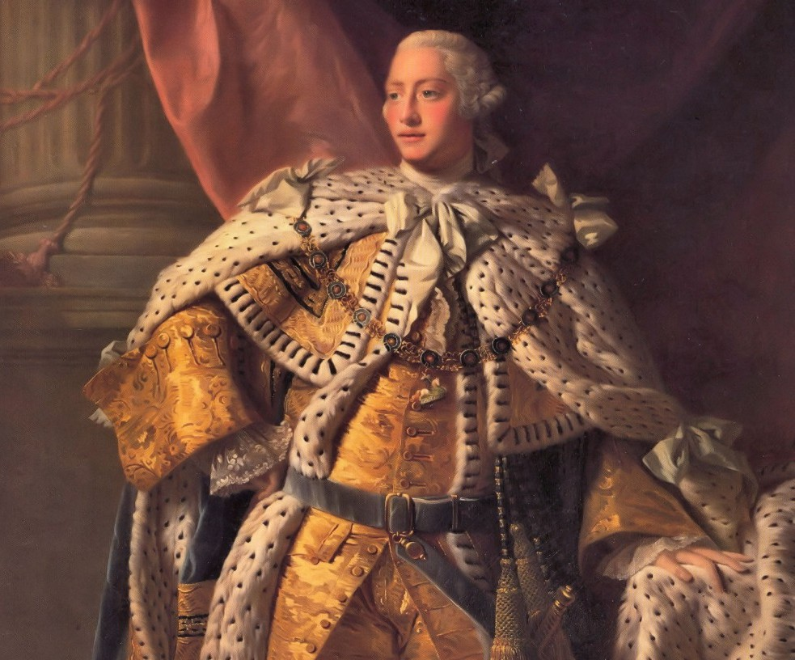
BAckground
-For the first 100 years of colonial
America, the British let the
colonists govern themselves with little
interference.
-After generations of self-reliance, the colonists found that they needed the British government less and less and began to grow resentful of their interference.
-As long as the colonies were profitable, the British left them alone.
Until…the British need money.

Slide 3
French and Indian War Lecture
This video will remind you of the causes of the French and Indian War and teach you reasons why it helped start the American Revolution. Please watch the video, take notes if you would like, and be ready to answer discussion questions. Be sure to be aware of the causes and effects of the war!
Watch the video below for a fun little lesson about the French and Indian War!
SONG: French and Indian War

Slide 4
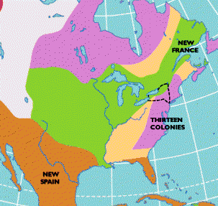
French and Indian War: the war that MADE america
War between Britain and France to control North America. (1754-1763)
Was a major cause of the Revolutionary War for two reasons:
  Proclamation of 1763 – banned all settlement west of the Appalachians to avoid more conflicts with Native Americans – this angered the colonists.
  Fighting this war caused economic hardship for the British which they passed on to the colonies through taxation.

Slide 5
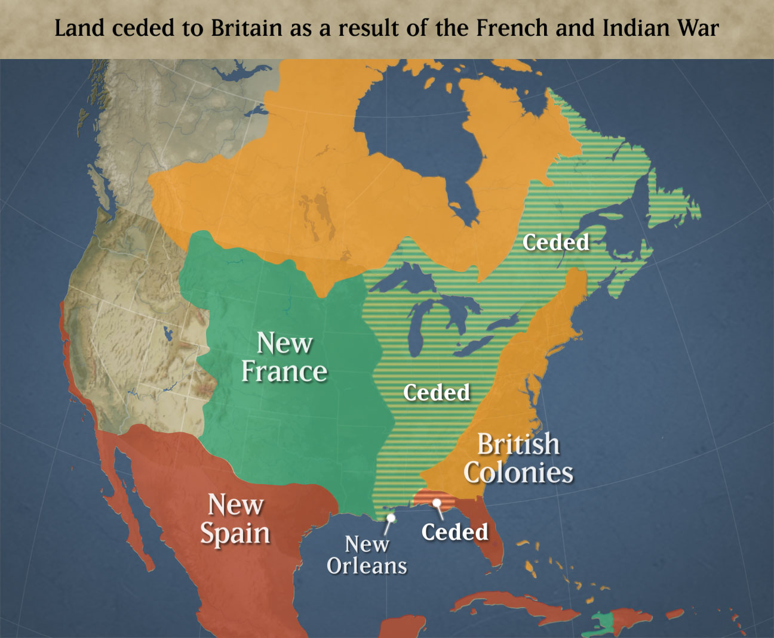

Slide 6
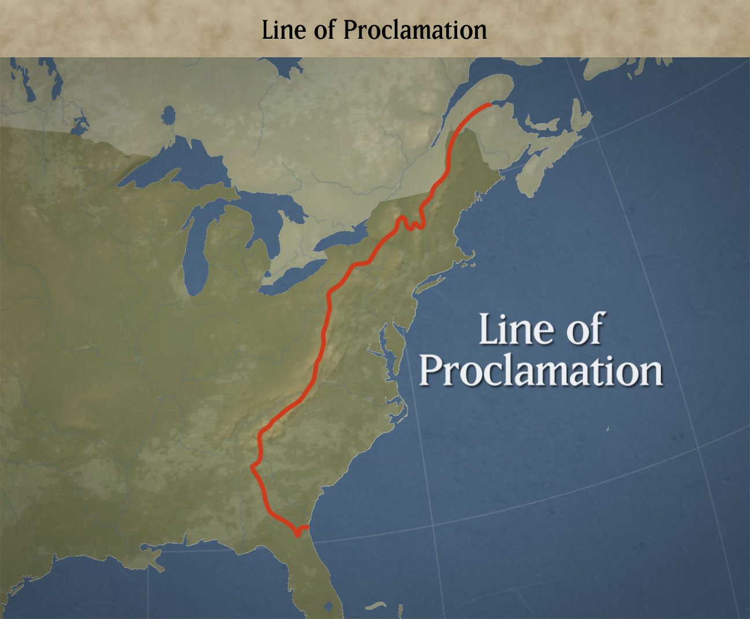
Why do you think this would anger the colonists? Why do you think Great Britain thought it was the right thing to do?Think about it, be ready to discuss. Read information on this link.LINK

Slide 7
Taxation without representation
The British felt that it was only right that the colonists helped pay for the debts of the French and Indian War because it benefited them.
They also needed the colonists to help pay for the soldiers that were being paid to guard the Proclamation Line.
A series of “Acts” were passed to impose taxes on the colonists.
Sugar Act 1764:taxed imported sugar & molasses-British given right to arrest suspected smugglers.
Stamp Act 1765: required all legal documents to bear a tax stamp that could only be purchased through official tax collectors.
  Ex: Wills, bills of sale, playing cards, newspapers
  Internal tax-this scared the colonists because all of the other taxes had been on imports.-declared the taxes “unlawful”
    Sons of Liberty formed
    Colonists organize to boycott British goods.
    Repealed in 1766

Slide 8
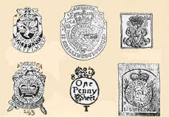
Videos
Stamp Act: Watch each video about the Stamp Act. Think about these questions. Why were the colonists upset about the Stamp Act? Why did the British and colonial loyalists think that it was okay to pass this act? Why is it considered and “internal” tax? Even though it was repealed, what lasting effect did it have?
Be ready to discuss in a discussion forum
Stamp Act:1
Stamp Act: 2

Slide 9
Growing British opposition
Townshend Acts/Duties 1767:
Series of acts passed by Parliament proposed by Charles Townshend.
Taxed imports including paper, paint, lead, tea, and glass-these items were not produced in the colonies so they were only aloud to buy from Great Britain.
Quartering Act: colonists had to provide food/their homes to British soldiers
The colonist’s opposition to internal taxes did not mean they would not oppose external taxes.
Patriot mobs staged further boycotts, burned shops and merchandise of merchants who continued to do business with Britain.
-The Sons of Liberty were a secret, underground organization that was founded in Boston by Samuel Adams and John Hancock in July 1765. The Sons of Liberty were opposed to the Stamp Act and their membership spread to a number of colonial towns.
-Great Britain repealed the Stamp Act because of the uproar, but still wanted to show the colonies that they could tax them and that they were in charge so they came up with other (external) ways to tax colonists.

Slide 10
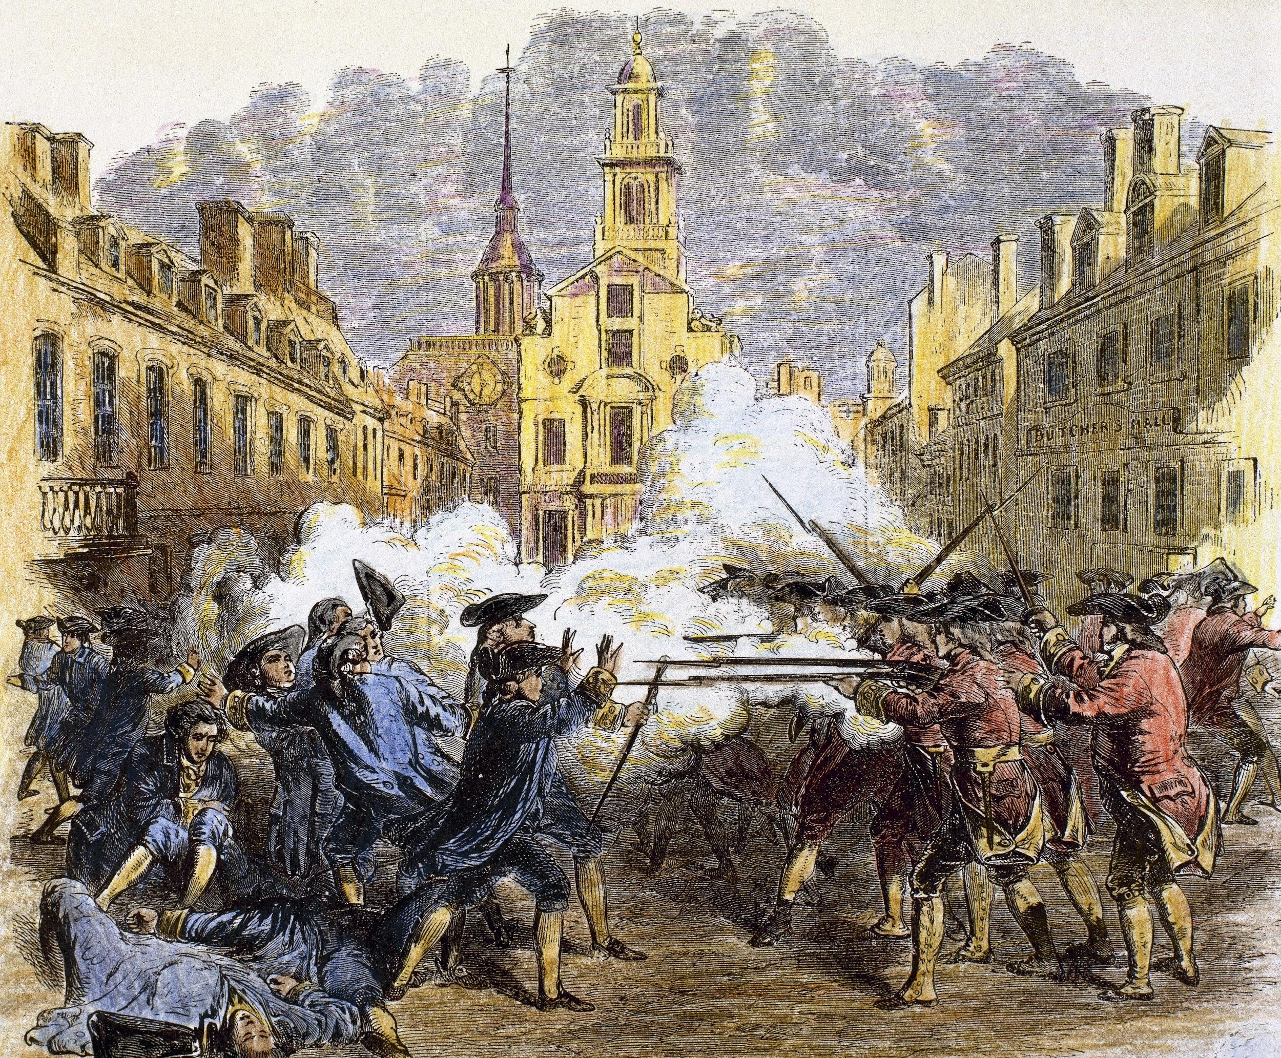
The culmination of all of these acts put together led to extreme hostility, verbal aggression, and physical altercations, especially in Boston. Tensions grew between the colonists and British soldiers, as well as with Patriots (those against the crown, trying to govern themselves) and the Loyalists (those in favor of British rule).
The next lesson will cover some of the effects of this turmoil, the most direct effect being:The Boston Massacre

