Slide 1
MIDWEST
State Capitals
Interactive Slides Practice

Slide 2
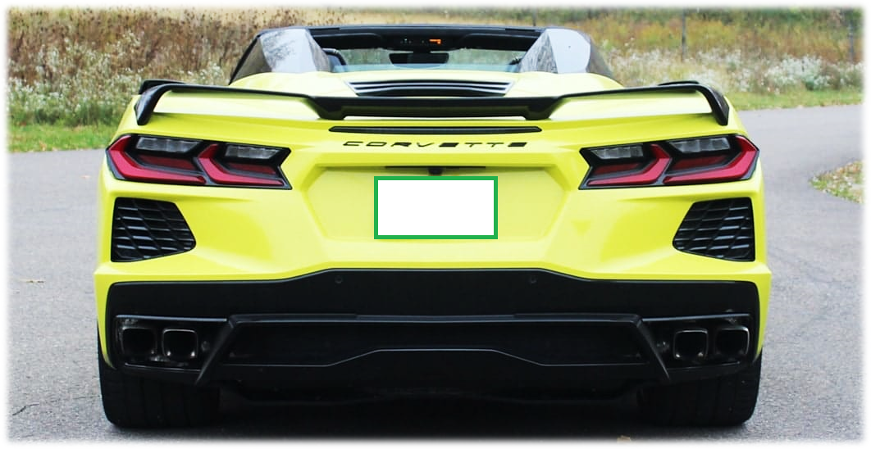

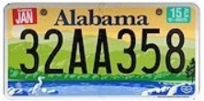



DIRECTIONS
On each slide you will be asked a question regarding U.S. State Capitals
Once you have read the capital, look at the license plate multiple choices below
Select the correct answer and move the correct plate on top of the open frame
Your final answer will look like this:
Phoenix

Slide 3



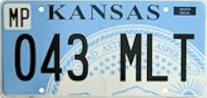
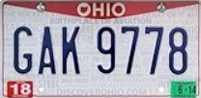
Midwest U.S. State Capital #1
Columbus

Slide 4
Midwest U.S. State Capital #2
Des Moines

Slide 5
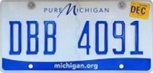
Midwest U.S. State Capital #3
Indianapolis

Slide 6
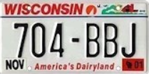
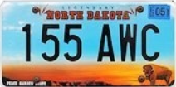
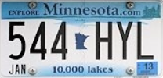
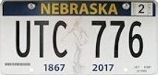
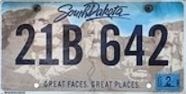
Midwest U.S. State Capital #4
Bismarck

Slide 7
Midwest U.S. State Capital #5
Lincoln

Slide 8
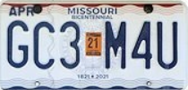
Midwest U.S. State Capital #6
Springfield

Slide 9
Midwest U.S. State Capital #7
Pierre

Slide 10
Midwest U.S. State Capital #8
Topeka

Slide 11
Midwest U.S. State Capital #9
St. Paul

Slide 12
Midwest U.S. State Capital #10
Jefferson City

Slide 13
Midwest U.S. State Capital #11
Lansing

Slide 14
Midwest U.S. State Capital #12
Madison

Slide 15
Midwest U.S. State Capitals
Please submit to Mr. Carlstrom when finished!
PLATES
North Dakota
Ohio
South Dakota
Wisconsin
Michigan
Minnesota
Missouri
Nebraska
Illinois
Indiana
Iowa
Kansas

