Slide 1
Writing Emails
Student Practice

Slide 2

Review of how to write emails
Review how to write email mini-lesson slides

Slide 3
Directions
Make a copy of this document
Read the directions on each slide
Fill in the blanks as needed

Slide 4
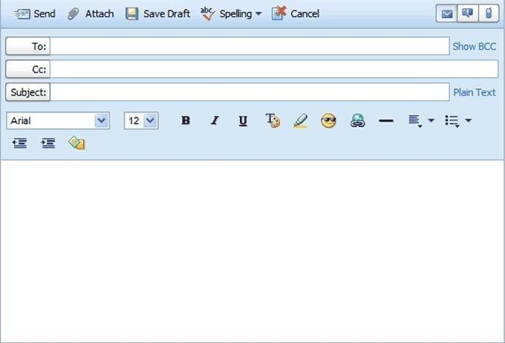
Email #1
Read the email and fill in the blanks.
Important information you may need to know:
Writers name: Samantha
Writers email: SRD2404@school.org
Teacher email: DSchultz12@hboe.org
Katie email: KBN8545@school.org
What else is missing?
Dear Mrs. Schultz,
I wanted to email you to find out when you will be announcing the leaders of the Genius Bar. My friend Katie and I are very excited to know the results.
Thank you for your time,
Samantha

Slide 5
Email #2
Read the email and fill in the blanks.
Important information you may need to know:
Writers name: Mackenzie
Dad’s email: JackK456@gmail.com
What else is missing?
KathyK123@gmail.com
My dad asked me to send you pictures of my school homecoming. You will find several pictures attached of me and my friends. I hope you are doing well, Aunt Kathy! Can’t wait to see you at Thanksgiving!

Slide 6
Email #3
Your teacher wrote you a very nice letter of recommendation. Email a thank you letter to her.
Important information you may need to know:
Writers name: {use your name}
Teacher name: Mrs. Smith
Teacher email: JSmith24@hboe.org
What else is missing?
Thank you!

Slide 7
Email #4
Read the email and fill in the blanks.
Important information you may need to know:
Writers name: Oliver
Writers email: OAG007@school.org
Teacher email: HHand33@hboe.org
What else is missing?
Dear Mrs. Hand,
Today I was not at school because I was home sick. Can you please let me know if I need to complete all of the assignments located on Canvas for today?
Thank you for the extra help!

Slide 8
Email #5
Read the email and fill in the blanks.
Important information you may need to know:
Writers name: Callie
Writers email: CTD1232@school.org
Group Members:
Katie email: KBN8545@school.org
Sophia email: SCG4543@school.org
Ella email: EAS9403@school.org
What else is missing?
Hello,
Our group project is due next Friday and we need to come up with a few dates to meet. Would everyone be available to have a first meeting tomorrow, right after school in the library? Please reply to all so we can keep track of who can make it.
Best,
Callie

Slide 9
Question 1
Explain how an email is different from a text message.

Slide 10
Question 2
Name three important parts you should never forget to include in your email.

Slide 11
Question 3
What does CC mean and why would you use it?

