Slide 1

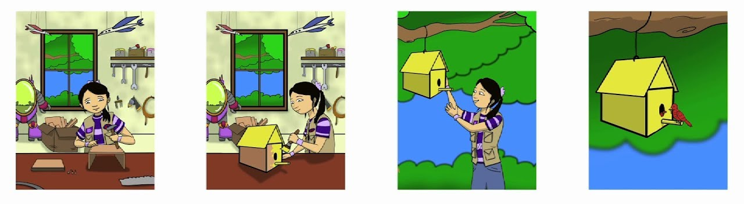
Story Retell
Sequencing Events

Slide 2
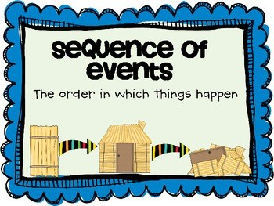
CCSS.ELA-LITERACY.RL.1.2
Retell stories, including key details and demonstrate understanding of their central message or lesson.
“I Can” Statement:
I can retell stories in sequence with important details.

Slide 3
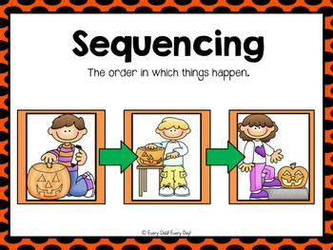

Slide 4
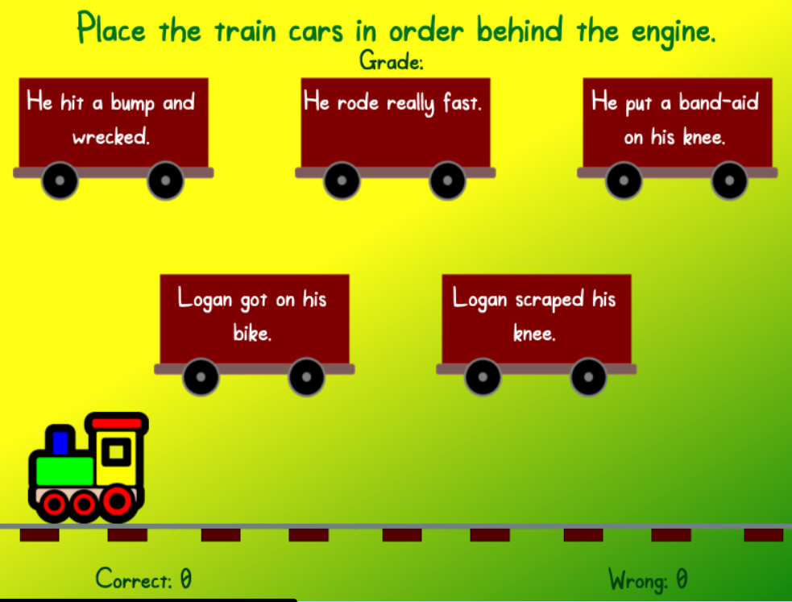
Let’s play a sequencing game!
(click on the picture to go to the game)

Slide 5


Slide 6
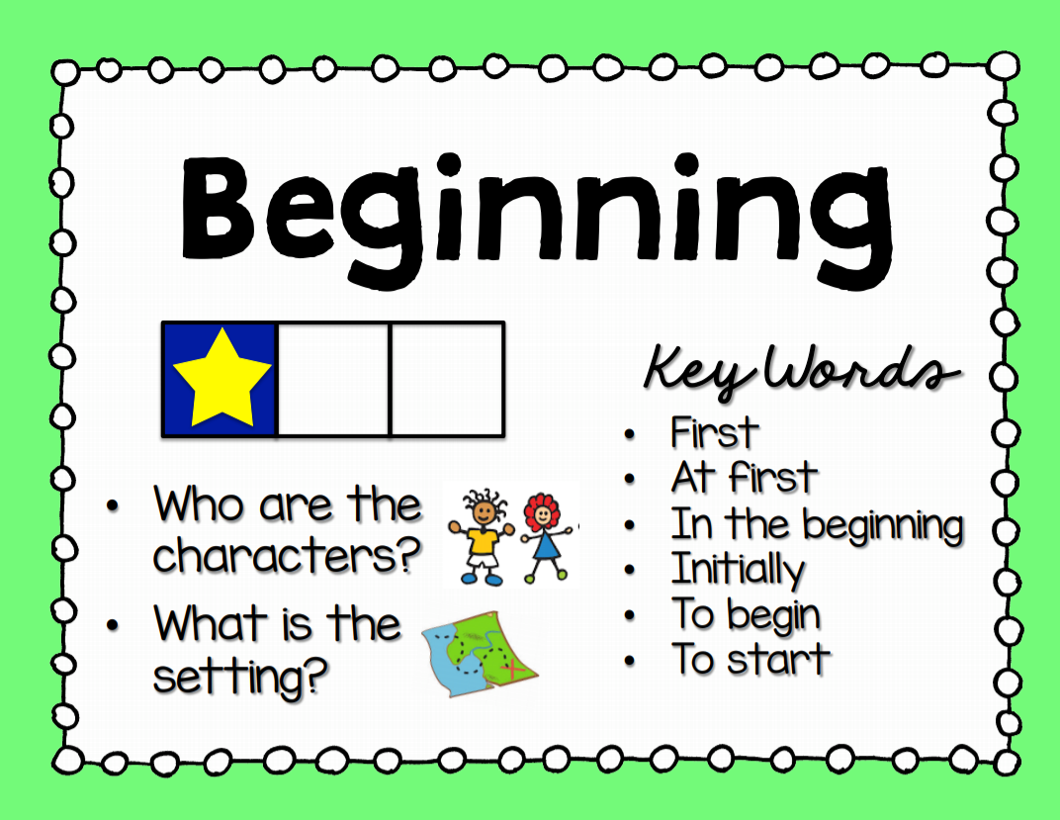

Slide 7
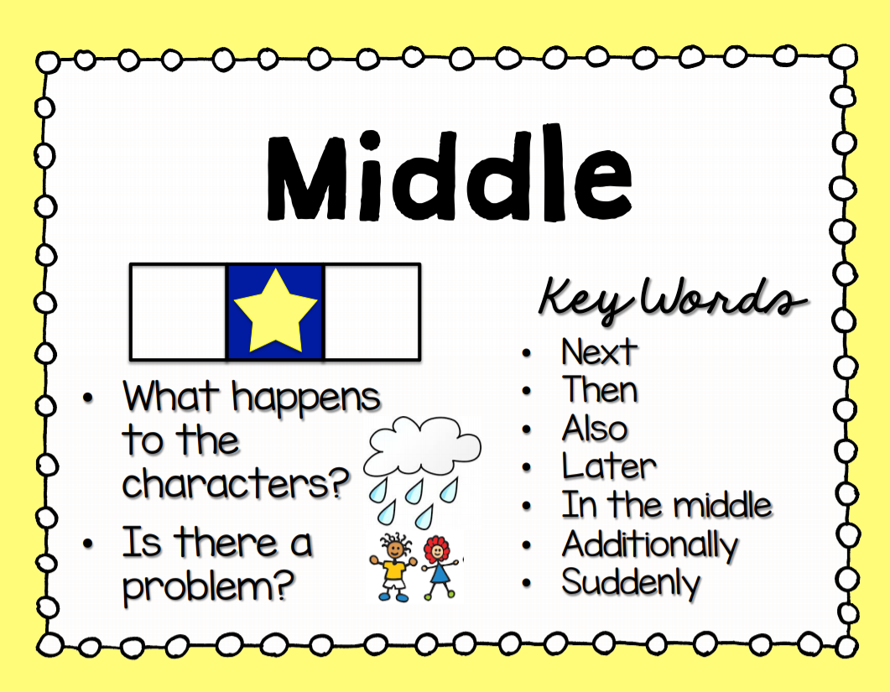

Slide 8
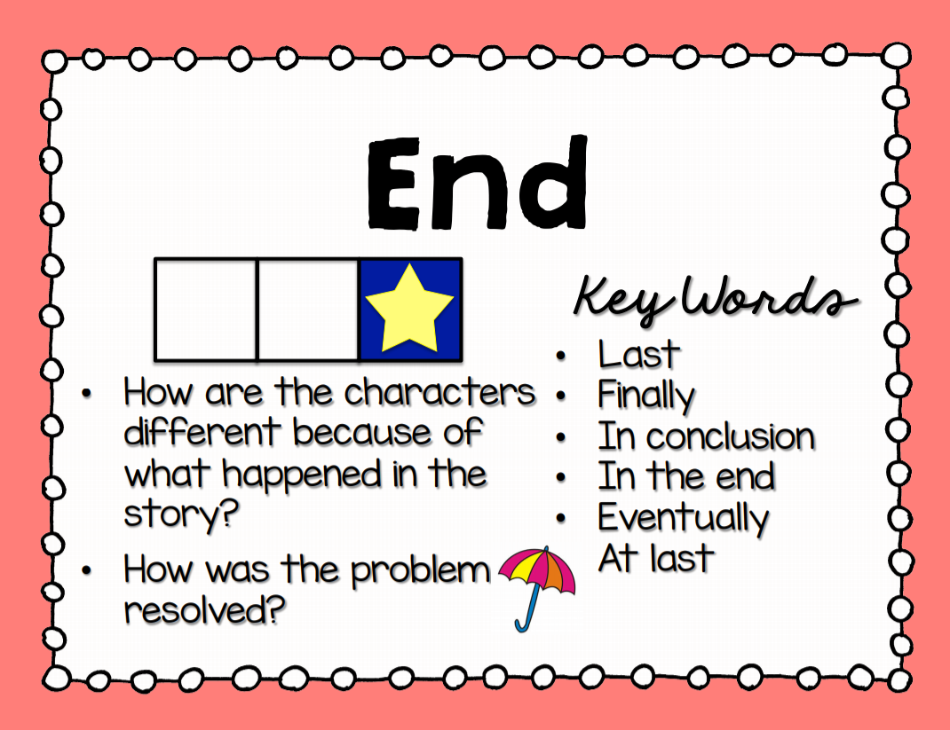

Slide 9
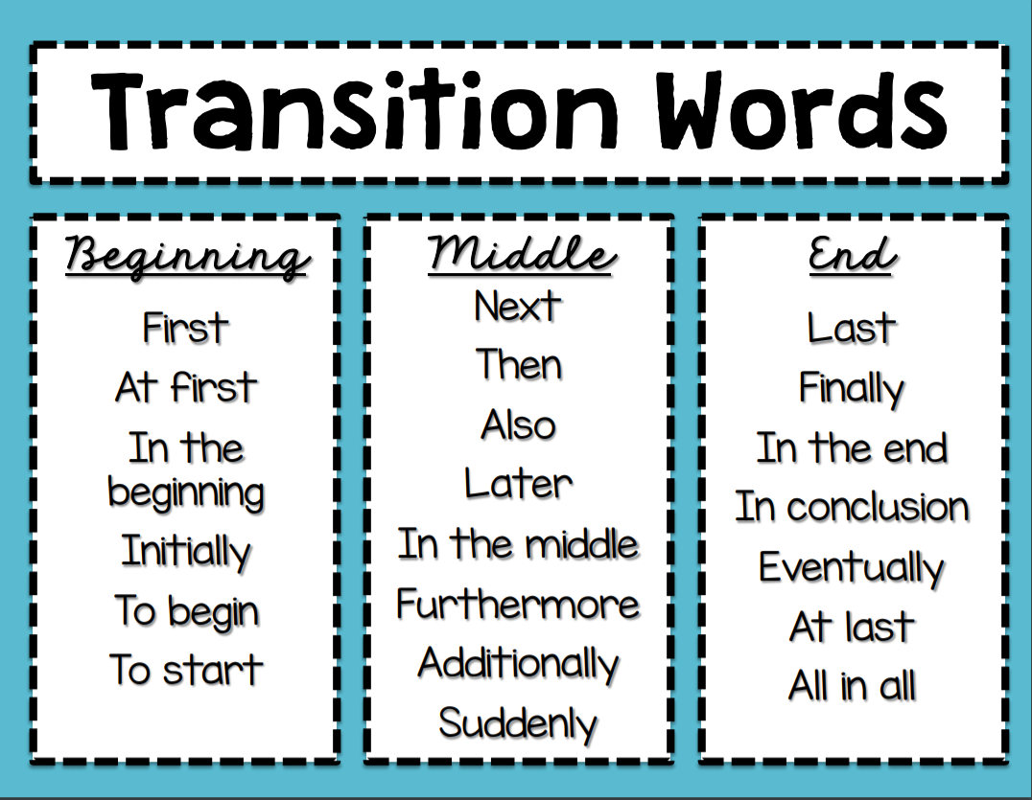

Slide 10
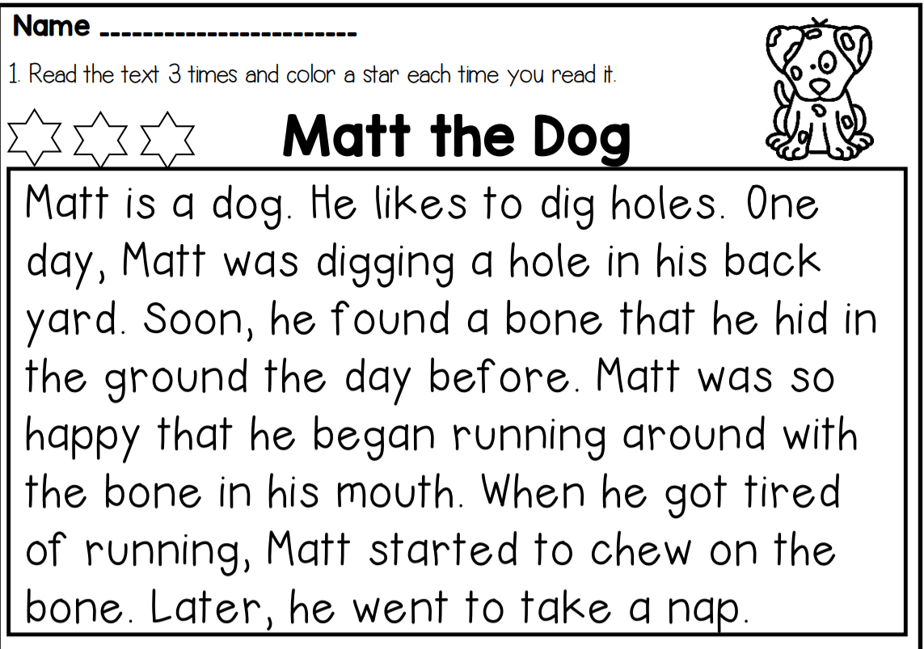

Slide 11
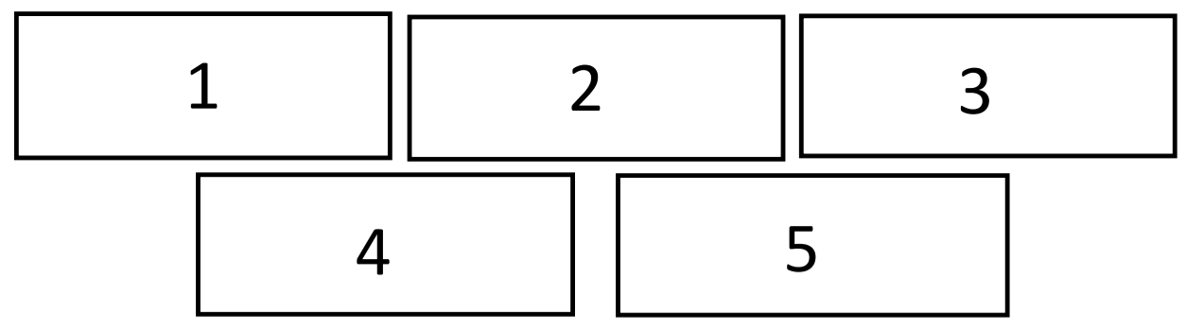
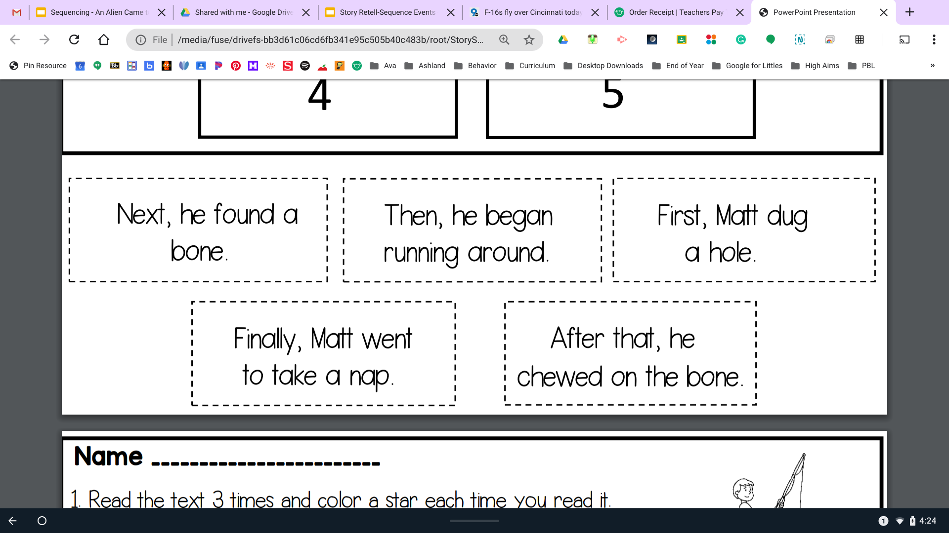

Slide 12
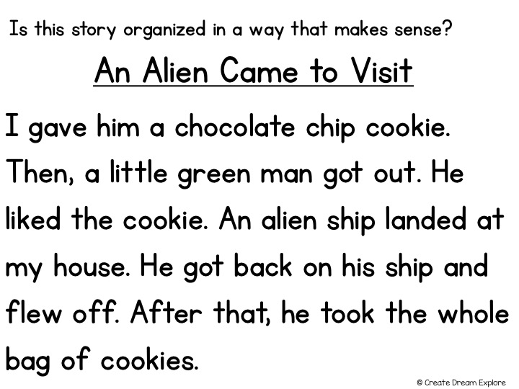

Slide 13
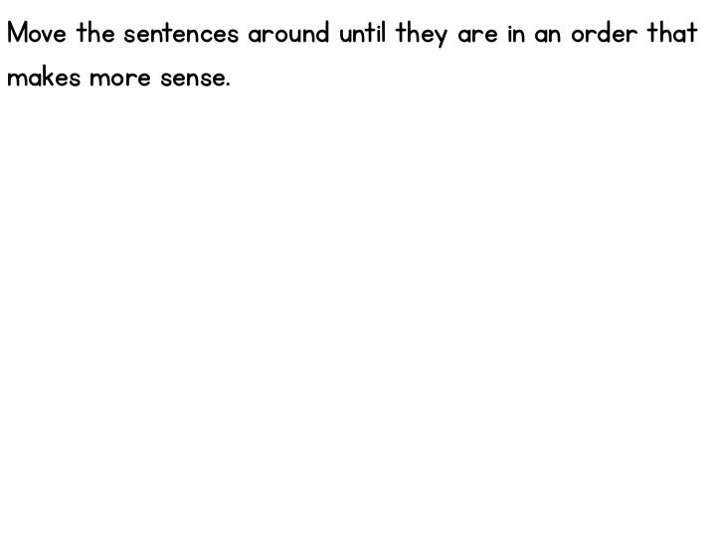







Slide 14
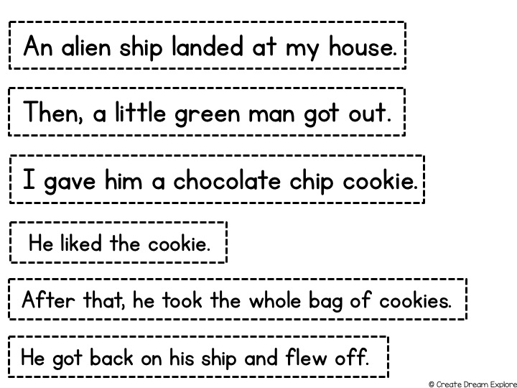
Slide each red bar away to see the correct answer.

Slide 15
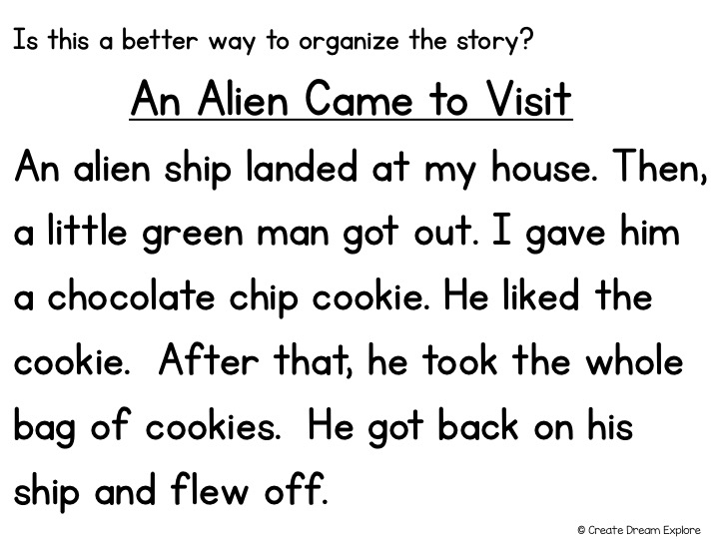
Slide this box out of the way to read the whole story all at once.

Slide 16
Now that we have sequenced the story let’s retell what happened in the beginning, middle and end.
Beginning
First, an alien landed at my house.
Middle
Next, a little green man got out.
Then, I gave him a cookie and he liked it.
End
Last, he got on his ship and flew off.

Slide 17
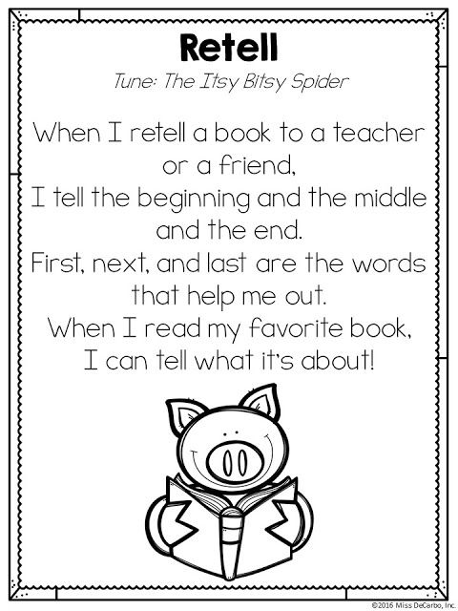
Let’s review with a poem!

