Slide 1

This lessons is on
Colors
Addition
Math Picture Logic Puzzles
  Answers to Math Picture Logic is on last slide

Slide 2








Colors | Place colored shape here | Shapes to choose from
Purple
Green
Orange
Red
Yellow
Brown
Blue
Gray
Move colors to their names

Slide 3








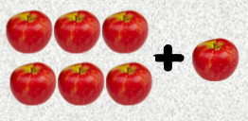





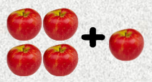


Slide 4
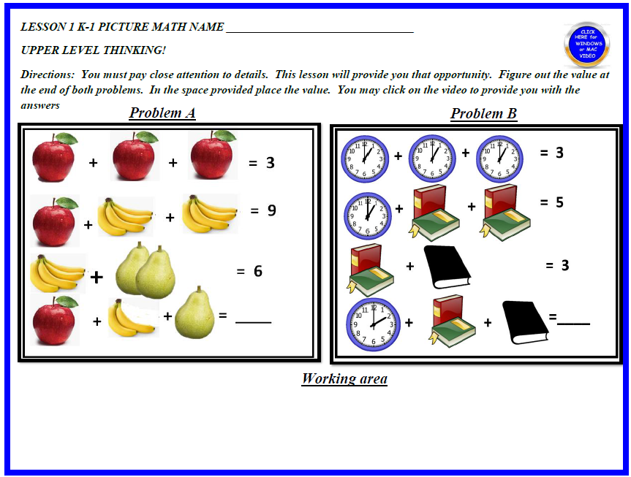

Slide 5
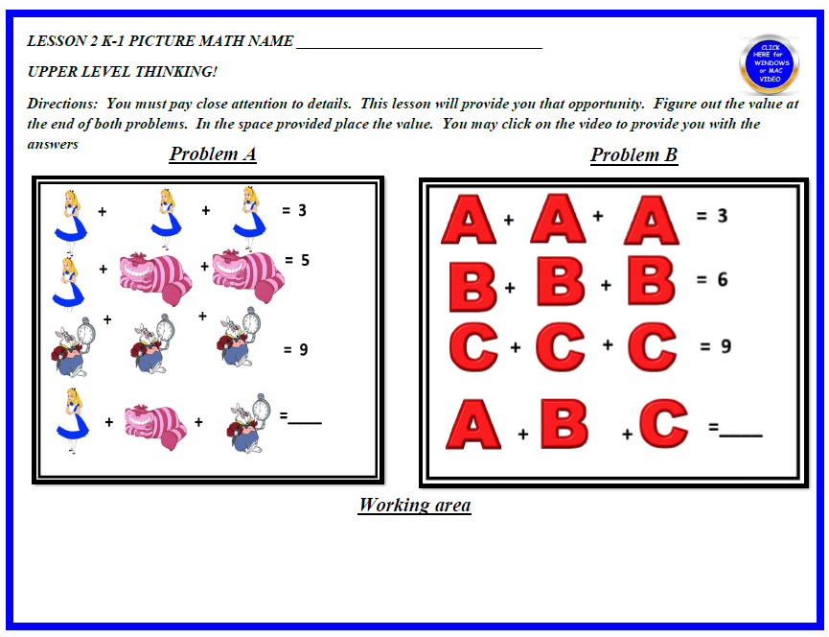

Slide 6
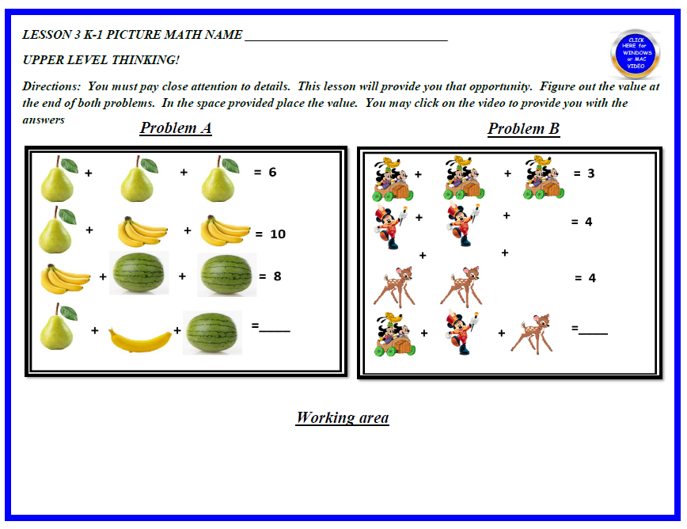

Slide 7
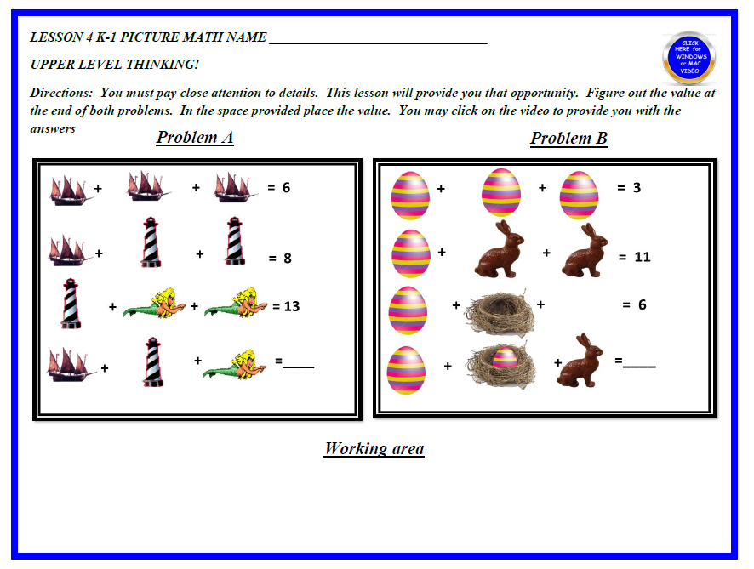

Slide 8
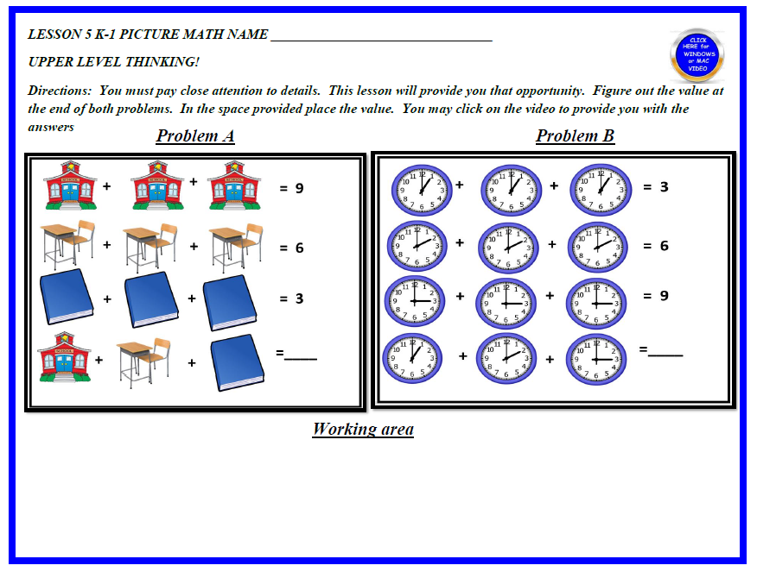

Slide 9
Answers to lessons
1: Problem A = 4 B = 5
2: Problem A = 6 B = 6
3 :Problem A = 5 B = 5
4 :Problem A = 10 B = 12
5 :Problem A = 6 B = 6

